Slide 1




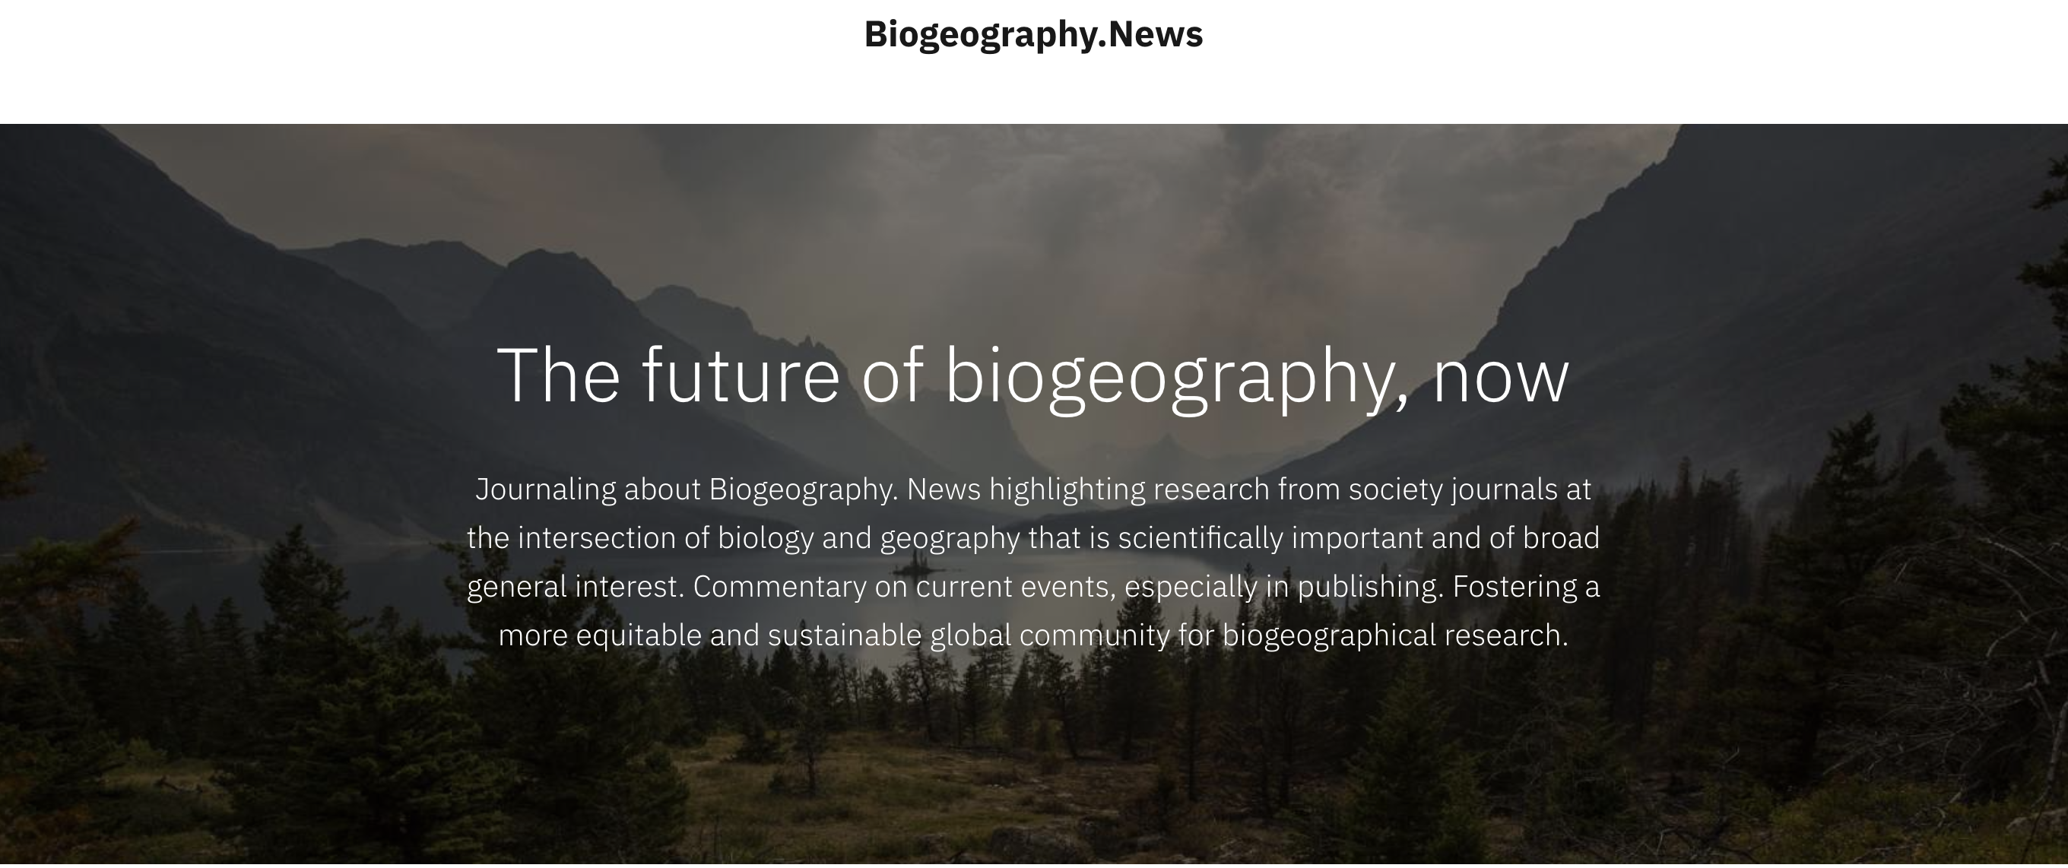



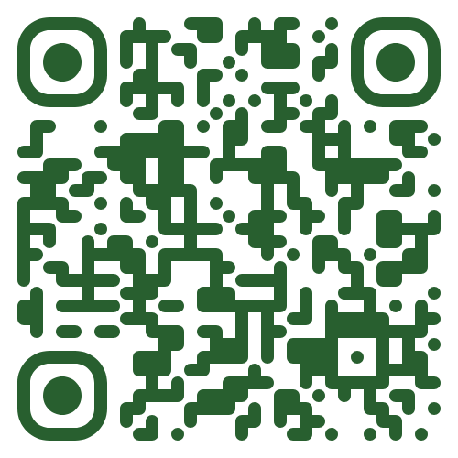





PEEER: Publishing for an Ethical and Equitable Environment in Research
To build a community of authors, editors, reviewers, libraries, publishers, and societies to support affordable and equitable access plus a healthy scientific and research community. In doing so, to change scientific publishing for the better.
Free Association
Blog promoting early career biogeographers
o f
Biogeographers
Community
of Thought
Community
of Practice
BiogeographyNews.org
Academic-owned, non-profit, Diamond Open Access Publishing
https://peeer.net
https://freeassociationbiogeography.org/
Notes:
If you are interested in participating in a coalition of authors, editors, reviewers, libraries, publishers, and societies — including The International Society of Biogeography — to support more affordable and equitable publishing, including:
Biogeography.News – a blog for promoting the research of early career biogeographers (with ASN, ESEB, IAVS, SIB1)
Biogeography, a new diamond open access journal (published with AMSA, SIB2, PKP, SUP)
Please visit the PEEER – Publishing for an Ethical and Equitable Environment in Research – table before the end of the meeting.
We have cool stickers and lots of information on how to identify journals in which to publish your biogeographical research.

