Slide 1
This slide-deck is targeted toward postdoctoral scholars (and late-stage graduate students) who are submitting/publishing their n^{th}-ish paper, know how the process works from an author perspective, who have done some reviewing, and who are interested in and/or will benefit from knowing more about the handling editor position and how to move into that position if they are interested to gain experience
Contact PEEER (peeeresearch@gmail.com) with questions or for any additional guidance on content and use.
If you use these resources for a workshop, please send details to peeeresearch@gmail.com so that we can track the use and impact of the resources.
Thank you for supporting #BetterPublishing!

Slide 2
PRE-WORKSHOP
Reminder email
Request to fill in Survey on relevant experience (e.g. how many papers published, career stage, have they reviewed papers, concerns about publishing)
https://docs.google.com/forms/d/e/1FAIpQLSeY3jr5Ym2k4RWxbLTdfTKi5WJlXZiy-nCC1TVjf-gnhLY0Cw/viewform?usp=header
Make Google folder accessible to all for groups to make notes in OR buy large sticky sheet poster sheets (so can display) – SPREADSHEET W/ NAMES & top three options / ‘why’
https://docs.google.com/spreadsheets/d/1g9evWxD-gj3LKxlz33z77h37ifxGiblpQe3HPUMlLK0/edit?usp=sharing
Make word clouds of any pre-survey / online questions (get R code)
https://simplewordcloud.com/
https://www.freewordcloudgenerator.com/generatewordcloud
https://wordart.com/create

Slide 3
POST-WORKSHOP
Thank you email with links to websites, talk slides, contact info, etc, request to complete post-workshop Survey.
Example text:
Dear workshop participants,
Thank you all again for participating in the afternoon PEEER workshop! We hope you enjoyed the conference and had safe journeys home!
The slide-deck with word clouds is attached.
Here are links to the six tools/guides for exploring journal choices:
Fair Open Access Alliance - https://fairoa.org/
Think.Check.Submit - https://thinkchecksubmit.org/about/
DAFNEE - https://dafnee.isem-evolution.fr/
Journal Targeter - https://jot.publichealth.yale.edu
JANE - https://jane.biosemantics.org
PEEER - https://peeer.net/
The links to the biogeography resources with PEEER are at
Biogeography – https://biog.journals.sup.org/
Biogeography.News – https://biogeographynews.org/
Free Association of Biogeographers – https://FreeAssociationBiogeography.org
Publishing for an Ethical and Equitable Environment in Research (PEEER) - https://peeer.net/
If you would like to learn more about, or get involved in, any of these, please either (1) join the Free Association of Biogeographers and/or PEEER or (2) write to me at mdawson@ucmerced.edu about your interests (e.g. recommending, editing, reviewing, training).
Remember that if you have questions, we and others are here to help answer them.
We would greatly appreciate you completing this short poll about the usefulness (or otherwise), and ways to improve, the workshop. https://forms.gle/aCh6VBbgRUxJfFN7A
Good luck with your research, publishing, reviewing, editing!

Slide 4
Notes:
Blank slide between preparatory notes and the workshop slides

Slide 5


Workshop Series: Successful Biogeography Publishing as Authors, Reviewers, and Editors
Part II: Effective reviewing and editing
Mike Dawson
University of California, Merced, USA
Tom Matthews
Birmingham University, UK
Helena Tukiainen
University of Oulu, Finland
with contributions from members of PEEER
Notes:
Briefly introduce yourselves as developing this workshop, based on the workshop series developed by PEEER (Publishing for an Ethical and Equitable Environment in Research) — a coalition of authors, editors, reviewers, libraries, publishers, and societies to support affordable and equitable access plus a healthy scientific and research community.
Add brief intro = personal journey, if it seems appropriate.

Slide 6
GOALS
Share experiences with reviewing and editing as ECRs, and discuss ways to deliver a constructive, quality, timely, process.
To better understand the structure of scientific publishing, including changes in recent decades, journal mechanics, and positive alternatives.
Be positioned to expand your career through meaningful community service as a reviewer and editor.
Meet some new colleagues to hang out with over the coming days!
Notes:
Share the goals for the workshop

Slide 7

AGENDA
Intro (10 mins)
Panel Discussion (50 mins)
- short break (5 mins)
Breakout Groups (55 mins)
- short break (5 mins)
Tips for success: reviewers, editors (25 mins)
Q&A (25 mins)
Closing remarks
BIGSTOCK
Notes:
Share the agenda. Timing can be expanded to a four-hour workshop primarily by giving more time for the breakout groups, extending breaks by 5 mins, allowing a little more time for the final Tips & QA sessions. (We encourage interruptions and questions in the Tips session, essentially merging the Tips+QA which leads to a more dynamic discussion.
Depending on your plans – if running Workshop 1 as well as Workshop 2, then a lunch between them provides participants with an opportunity to mingle (as well as with panelists and organizers). Advertise this before the workshop.
Also, note that you’ll get some folk take both workshops. That seems to work ok.

Slide 8

AGENDA
Intro (10 mins)
Panel Discussion (50 mins)
- short break (5 mins)
Breakout Groups (55 mins)
- short break (5 mins)
Tips for success: reviewers, editors (25 mins)
Q&A (25 mins)
Closing remarks

Slide 9
Workshop:
WHY: Effective reviewing and editing?
22,000
Biogeography
Nature Biodiv. Rev.
Current changes in scientific publishing are among the most radical in >350 years: the digital revolution, more rapidly expanding publishing options, publish-or-perish, ...
BSSB
NPJ Biodiv.
Evol Lett
Nature E&E
DDI
GEB
JEB
# of journals ===>
JBI
Frontiers of
Biogeography
Biogeographia
Syst Biol
# scientific
journals
PTRSL
Am Nat
Evolution
Key:
Society-owned
Publisher-owned
ecology/evolution
biogeography
Notes:
Why are we offering this workshop?
Current changes in publishing [see slide text] … including changing ownership of journals.
From 1655–1960s, almost all journals were owned and run by societies. In recent years (taking root in the 1960s–1990s), the rate of creation of new journals has accelerated, the vast majority of new journals have been for-profit publisher-owned, including predatory publishers, MDPI, Frontiers.in, and cascade journals at all the major publishers.

Slide 10
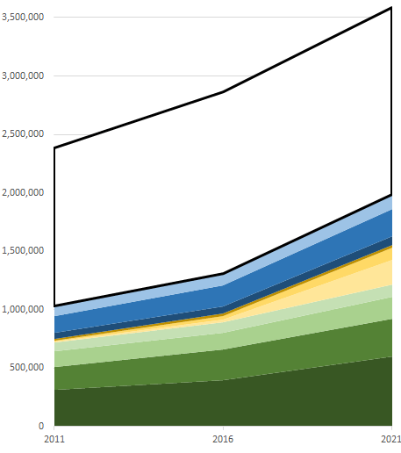
Workshop:
WHY: Effective reviewing and editing?
22,000
Biogeography
Nature Biodiv. Rev.
BSSB
NPJ Biodiv.
… the numbers of manuscripts that need handling is skyrocketing too ...
Small for-profit
Evol Lett
Nature E&E
Others (in Scopus, not ISI)
University presses
Societies
Public Library of Science
other for-profit OA
MDPI
Taylor & Francis
Wiley
DDI
GEB
Nature Springer
JEB
Elsevier
JBI
Frontiers of
Biogeography
Biogeographia
Syst Biol
# scientific
journals
PTRSL
Am Nat
Evolution
Key:
Society-owned
Publisher-owned
ecology/evolution
biogeography
https://dynamicecology.wordpress.com/2024/04/29/the-state-of-academic-publishing-in-3-graphs-5-trends-and-4-thoughts/
Notes:
The number of published papers has similarly grown rapidly – likely beyond our ability to keep up with the field or synthesize it (without aid of tools).
Figure 1 – the growth of # of papers published in total and broken out by publisher 2011-2021. Green are for-profit publishers. Yellow/Gold are newer OA only publishers (for profit except PLOS). Blue are not-for-profit publishers. Colored region indicates papers in ISI. White block indicates additional papers in Scopus. There are probably some different proportions among publishers for in-Scopus-not-in-ISI papers, but I don’t think the fundamental story changes much.Sources https://www.stm-assoc.org/oa-dashboard/uptake-of-open-access/ provides total publications in Scopus; Table 1 of https://link.springer.com/article/10.1007/s11192-022-04586-1/tables/1 for ISI journals by publisher.

Slide 11
Workshop:
WHY: Effective reviewing and editing?
22,000
Biogeography
Vast majority of journals are for-profit.
APCs increasing faster than inflation.
Nature Biodiv. Rev.
BSSB
NPJ Biodiv.
… the numbers of manuscripts that need handling is skyrocketing too ...
Small for-profit
Evol Lett
Nature E&E
Others (in Scopus, not ISI)
University presses
Societies
Public Library of Science
other for-profit OA
MDPI
Taylor & Francis
Wiley
DDI
GEB
Nature Springer
JEB
Elsevier
JBI
Frontiers of
Biogeography
Biogeographia
Syst Biol
# scientific
journals
PTRSL
Am Nat
Evolution
Key:
Society-owned
Publisher-owned
ecology/evolution
biogeography
https://dynamicecology.wordpress.com/2024/04/29/the-state-of-academic-publishing-in-3-graphs-5-trends-and-4-thoughts/
Notes:
Not only are the vast majority of journals for-profit, the way we pay for science has changed – shifiting toward open access, with fees increasing faster than inflation. The system has become inaccessible to many and unsustainable for most if not all researchers.
Figure 1 – the growth of # of papers published in total and broken out by publisher 2011-2021. Green are for-profit publishers. Yellow/Gold are newer OA only publishers (for profit except PLOS). Blue are not-for-profit publishers. Colored region indicates papers in ISI. White block indicates additional papers in Scopus. There are probably some different proportions among publishers for in-Scopus-not-in-ISI papers, but I don’t think the fundamental story changes much.Sources https://www.stm-assoc.org/oa-dashboard/uptake-of-open-access/ provides total publications in Scopus; Table 1 of https://link.springer.com/article/10.1007/s11192-022-04586-1/tables/1 for ISI journals by publisher.

Slide 12
Workshop:
WHY: Effective reviewing and editing
22,000
Biogeography
Nature Biodiv. Rev.
BSSB
Reviewing
is declining
NPJ Biodiv.
… it is increasingly difficult to get peer reviews ...
Evol Lett
Nature E&E
… will be extinct by 2050!
DDI
GEB
JEB
JBI
Frontiers of
Biogeography
Biogeographia
Syst Biol
# scientific
journals
PTRSL
Am Nat
Evolution
Key:
Society-owned
Publisher-owned
ecology/evolution
biogeography
Dawson, MN (2022) J. Biogeography 50:41-42. https://doi.org/10.1111/jbi.14567
Notes:
These increases are coupled with a decrease in willingness to review articles – possibly a sign of an increasing intensity of the ‘publish or perish’ phenomenon.

Slide 13
… by multiple measures, scientific publishing is in a crisis!
22,000
Vast majority of journals are for-profit.
APCs increasing faster than inflation.
Nature Biodiv. Rev.
BSSB
Reviewing
is declining
NPJ Biodiv.
Small for-profit
Evol Lett
Nature E&E
Others (in Scopus, not ISI)
University presses
Societies
Public Library of Science
other for-profit OA
MDPI
Taylor & Francis
… will be extinct by 2050!
Wiley
DDI
GEB
Nature Springer
JEB
Elsevier
JBI
Frontiers of
Biogeography
Biogeographia
Syst Biol
# scientific
journals
PTRSL
Am Nat
Evolution
Key:
Society-owned
Publisher-owned
ecology/evolution
biogeography
Notes:
Shift to open access - original goals of OA vs. co-opted goals and drive for more and more papers
McGill blogposts

Slide 14
Workshop Series: Successful Biogeography Publishing as Authors, Reviewers, and Editors
Part II: Effective reviewing and editing
This in-person workshop will discuss strategies for reviewing & editing in the increasingly complicated publishing landscape, and for being successful.
Activities will seek opportunities for input on these from participating early career researchers and discuss how you would like scientific publishing to evolve to better support the research community in the future.
Notes:
So, this workshop will … [paraphrase slide text]

Slide 15

Principles of Community
We have shared interests in being successful in an improved publishing environment.
In achieving that goal we may have to address inequalities, unfamiliar topics, individual experiences. We ask that everyone listens, learns, and shows respect and understanding.
Congress SAFE Policy: https://www.evolutionmeetings.org/safe-evolution.html
Code of Conduct: https://www.evolutionmeetings.org/policies.html
Notes:
In terms of workshop logistics/tenor, please remember that …[paraphrase slide text]

Slide 16

AGENDA
Intro (10 mins)
Panel Discussion (50 mins)
- short break (5 mins)
Breakout Groups (55 mins)
- short break (5 mins)
Tips for success: reviewers, editors (25 mins)
Q&A (25 mins)
Closing remarks

Slide 17
Panel Discussion - Q & A (50 mins)
Plan:
To share experiences in publishing, reviewing, editing and solutions to challenges
Schedule:
Brief self-introduction by panelists
Question & answer session
e.g. motivations for reviewing, editing
e.g. editorial and peer–review process
e.g. enacting cultural change
open mic
Break (~5 mins)
Notes:
WARM-UP QUESTIONS IF NEEDED
(Motivations for reviewing/editing)
Motivations for publishing/reviewing/editing: Evaluations? Personal satisfaction?
What are the various considerations experienced when choosing a venue?
How do the current metrics for evaluating research (e.g., impact factor, h-index) affect your choices
(Peer review process)
How do journal publishers ensure transparency in their editorial and review processes, and what improvements could be made to increase trust in these processes?
What are the potential benefits and challenges of preprint servers, and how can they be effectively integrated into the publishing landscape?
What role do editors/societies/publishers/librarians play in supporting ECRs through the publishing process, and how can this support be enhanced?
(Enacting cultural change)
What are the main barriers to affordable open access publications, and how can these barriers be reduced?
What initiatives can journals implement to ensure a more equitable and inclusive publishing process for researchers (think globally)?
What strategies can be implemented in different institutions to ensure that researchers from underrepresented regions and institutions have equitable opportunities in the publishing process?
What role could scientific societies play in ameliorating the current situation?
What “we/you” as researchers can do?

Slide 18
Panelists:
Name | Institution | Position. Relevant experience.
Name | Institution | Position. Experience.
Name | Institution | Position. Relevant experience.
Name | Institution | Position. Experience.
Notes:
Invite panelists to introduce themselves, during which they might also give a short anecdote of a pivotal experience in publishing themselves.
Then, to transition to audience questions you might:
Ask the audience a question or two first, e.g. about how many of them have published a paper, what career stage they’re at, or similar relevant things. (If you run a pre-workshop survey, you may have asked some of these questions and know the answers … but it is useful for everyone in the room to know who’s there, and is a good ice-breaker too)
Prepare a few warm-up questions, in case needed
Start the audience questions as soon as possible

Slide 19
5 mins break
*check email for link
needed for the next step
https://docs.google.com/spreadsheets/d/1gi3eG-Npdmme8DCvasM9UaJKTPkBYEqLzzXHhyPBsQU/edit?usp=sharing
Notes:
Note that this link should be synchronized with the links in the email sent to participants before the workshop (see initial three slides) and with the links on the slides during the breakout sessions.
We usually cue up the email to send a few minutes before the end of the panel session, or during the break (if it’s a longish break).
You may want to extend this break a little, depending on how long you have for the workshop, how long the prior session was, whether you’ve got refreshments, etc …

Slide 20

AGENDA
Intro (10 mins)
Panel Discussion (50 mins)
- short break (5 mins)
Breakout Groups (55 mins)
- short break (5 mins)
Tips for success: reviewers, editors (25 mins)
Q&A (25 mins)
Closing remarks

Slide 21

Breakout groups (55 mins)
Plan: To share experiences in reviewing and editing, and solutions to challenges encountered
Schedule: x2!!
Form 4 groups; each group designate a
facilitator/moderator, time-keeper, scribe, reporter) (<5 mins)
Discuss prompts (~10 mins)
Shareback (~10 mins)
Please use this document to organize your notes for the shareback
https://docs.google.com/spreadsheets/d/1gi3eG-Npdmme8DCvasM9UaJKTPkBYEqLzzXHhyPBsQU/edit?usp=sharing

Slide 22
Breakout groups – session A
What is “successful” reviewing, editing?
GRP 1 & 2: Reflect on your experiences as an author, how was the review process?
GRP 3 & 4: For those who have reviewed, how did you approach it?
What was the process? What was good? What was bad? Anything you’d do differently?
Editors: How do your processes intersect? Do you / Does your journal have guidelines for reviewers?
Notes:
In black are the two main prompts. Grey text is supplementary guidance, about possible ways to think about consolidating their thoughts.
Oftentimes you’ll get editors, publishers also sign up for the workshop. That is ok. Just find out who they are, and they can either
Join groups in low numbers to facilitate the discussion, or
Form a fifth group (see bottom line on the slide) prepared to provide perspectives that intersect whatever matters are raised by the prior two pairs of groups.
N.B. We don’t use a word cloud for this as (a) it allows for freer, unrecorded, non-permanent conversation about potentially sensitive topics.

Slide 23
Shareback - session A
Summarise your discussion in ≤ 2 minutes :)
How was the review process, from perspective of authors?
Group #1 …
… Group #2 anything to add?
How did you/journal handle review?
Group #3 …
… Group #4 anything to add?
What was the process? What was good?
What was not good?
Anything you’d do differently?
Notes:
The first group on each topic should provide the major input. The second group fills in details or addresses missing points.
Have both pairs contribute.
After the pairs of groups contribute, invite the Editors: How do your processes intersect? Do you / Does your journal have guidelines for reviewers?

Slide 24
Breakout groups – session B
Disagreements / Appealing a decision:
GRP 1 & 2: As an author/reviewer, how have you seen editors handle difficult situations? Have you pushed back against decisions?
GRP 3 & 4: As an editor, how have/would you approach conflicting reviews and opinionated authors/reviewers?
If you were writing a guide for editors, what would be the top two-or-three points?
Editors: How do your processes intersect? Do you / Does your journal have guidelines for reviewers?
Notes:
People may relate specific actual experiences, but of course must respect confidentiality of any journals/persons
They may be personal, first-hand, or from very close colleagues, but should not be hearsay
They can choose to anonymyze them, e.g. a personal experience might be “one that experienced among my close colleagues …”
N.B. We don’t use a word cloud for this as (a) it allows for freer, unrecorded, non-permanent conversation about potentially sensitive topics.

Slide 25
Shareback - session B
Summarise your discussion in ≤ 2 minutes :)
As author/reviewer, how have editors handled difficult situations? Have you pushed back?
Group #2 …
… Group #1 anything to add?
As an editor, how approach conflicting reviews, opinionated author/reviewer?
Group #4 …
… Group #3 anything to add?

Slide 26
Successful Biogeography Reviewing/Editing
With the preceding discussion in mind, let’s begin with our definition of success:
What characteristics of reviewing should we model & foster?
-
What characteristics of editing should we model & foster?
-
This is where we’ll pick up the next Tips and Q&A session …
If you were writing a guide for editors, what would be the top two-or-three points?
document for shareback
https://docs.google.com/spreadsheets/d/1gi3eG-Npdmme8DCvasM9UaJKTPkBYEqLzzXHhyPBsQU/edit?usp=sharing
PleaseUseCamelbackText
Notes:
For this, we use a word cloud as its less sensitive and provides a summary of the wisdom from the group for everyone to take home and a list of potential targets for subsequent discussion/work.

Slide 27
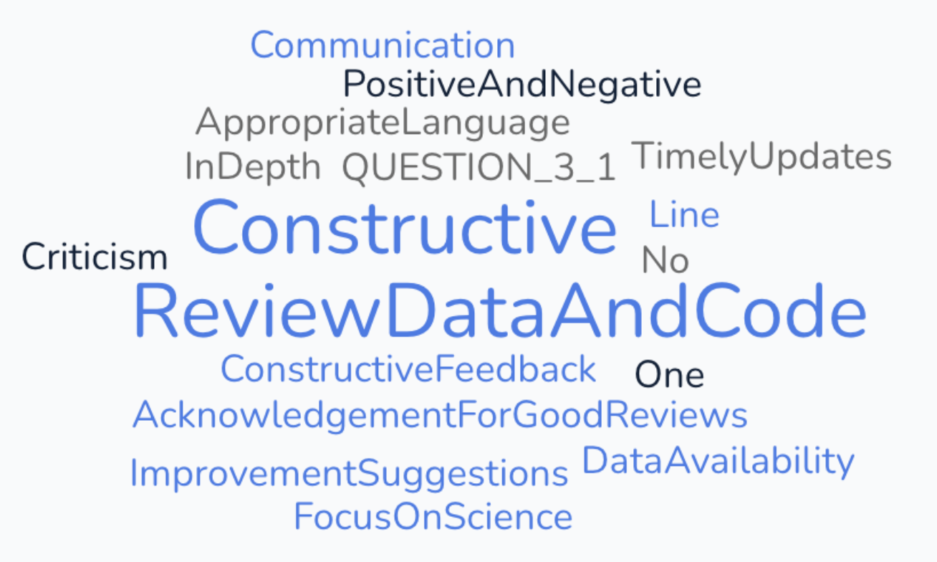
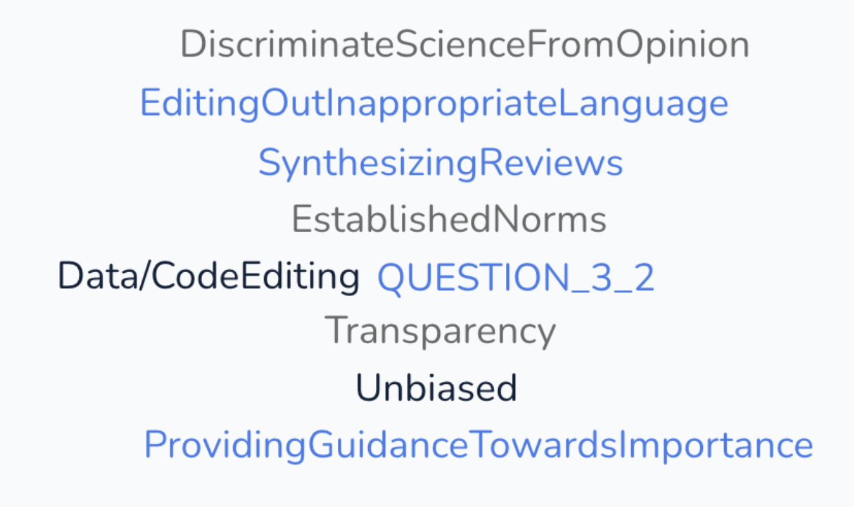
What characteristics of reviewing should we model & foster?
What characteristics of editing should we model & foster?
Notes:
Before you start the workshop, delete the four wordclouds from this slide. You will generate new wordclouds using the new workshop participants’ input.
During the workshop, we usually just make the wordclouds in the browser (https://simplewordcloud.com/ has proven simple and reliable to date) and show them there, to save time rather than copying and pasting. We add the screenshots later, before sharing a PDF with the workshop participants.

Slide 28
5 mins break

Slide 29

AGENDA
Intro (10 mins)
Panel Discussion (50 mins)
- short break (5 mins)
Breakout Groups (55 mins)
- short break (5 mins)
Tips for success: reviewers, editors (25 mins)
Q&A (25 mins)
Closing remarks

Slide 30
Successful Biogeography Editing
What we don’t want: low-touch, prestige-focused, quantity over quality
What we wish to support: high-touch, high quality, timely review process that supports authors and the community at accessible, affordable journals, helping people in the discipline be successful and creative.
----------------------+----------------------
Goal: provide perspectives from editors, authors and reviewers on how to increase success
Notes:
Briefly discuss shared lessons/meaning, linking to the points made during prior excersis and summarized in the wordcloud.

Slide 31
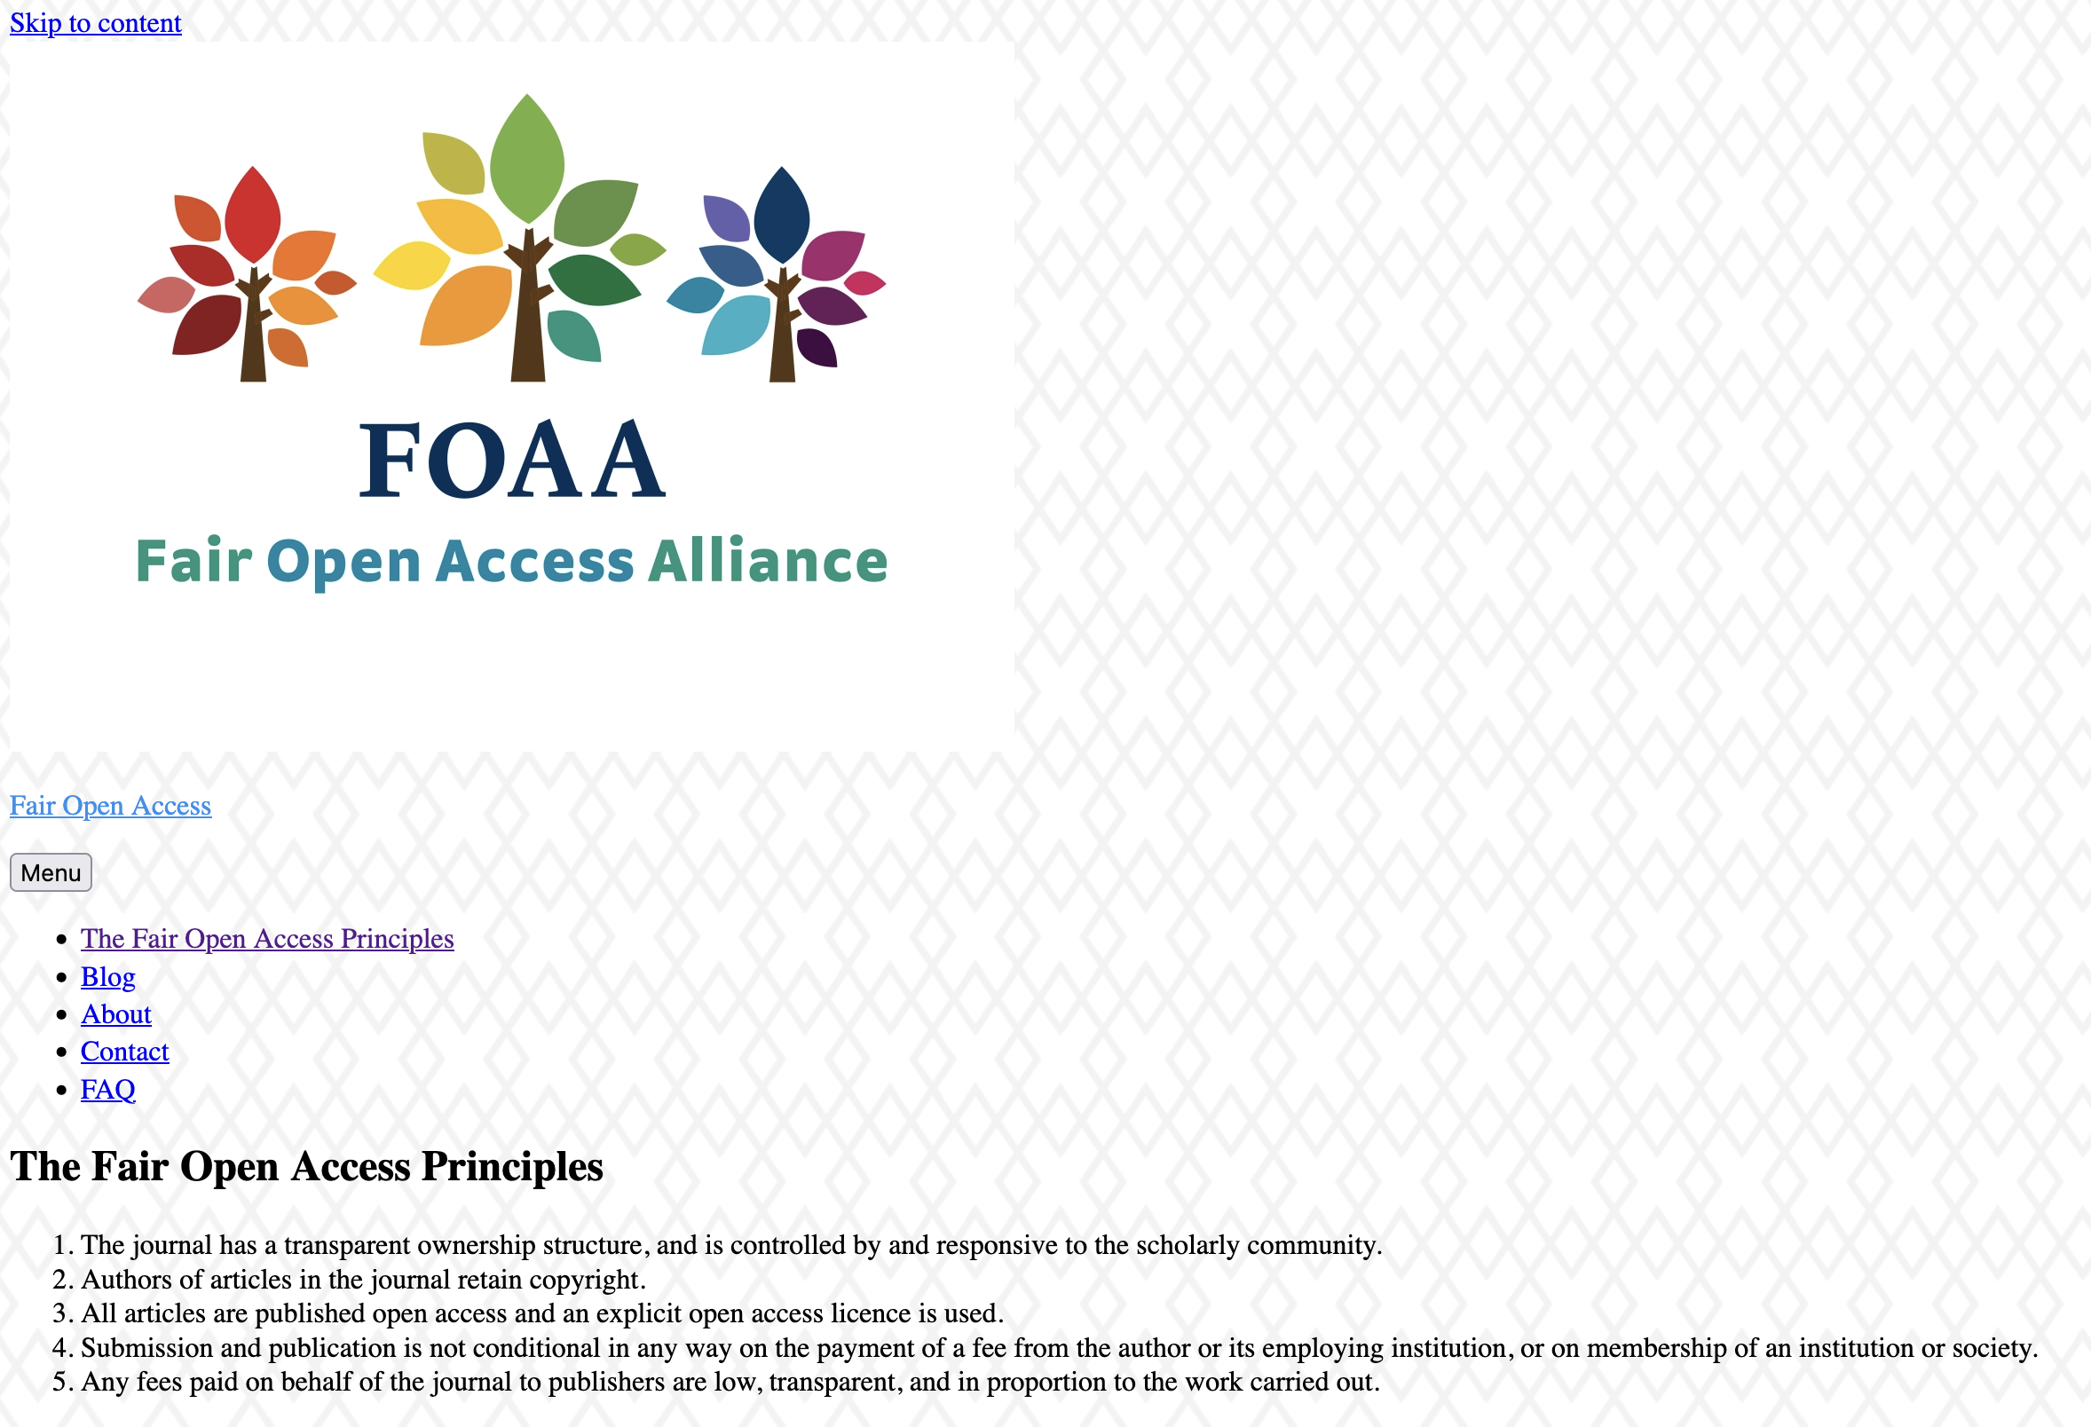

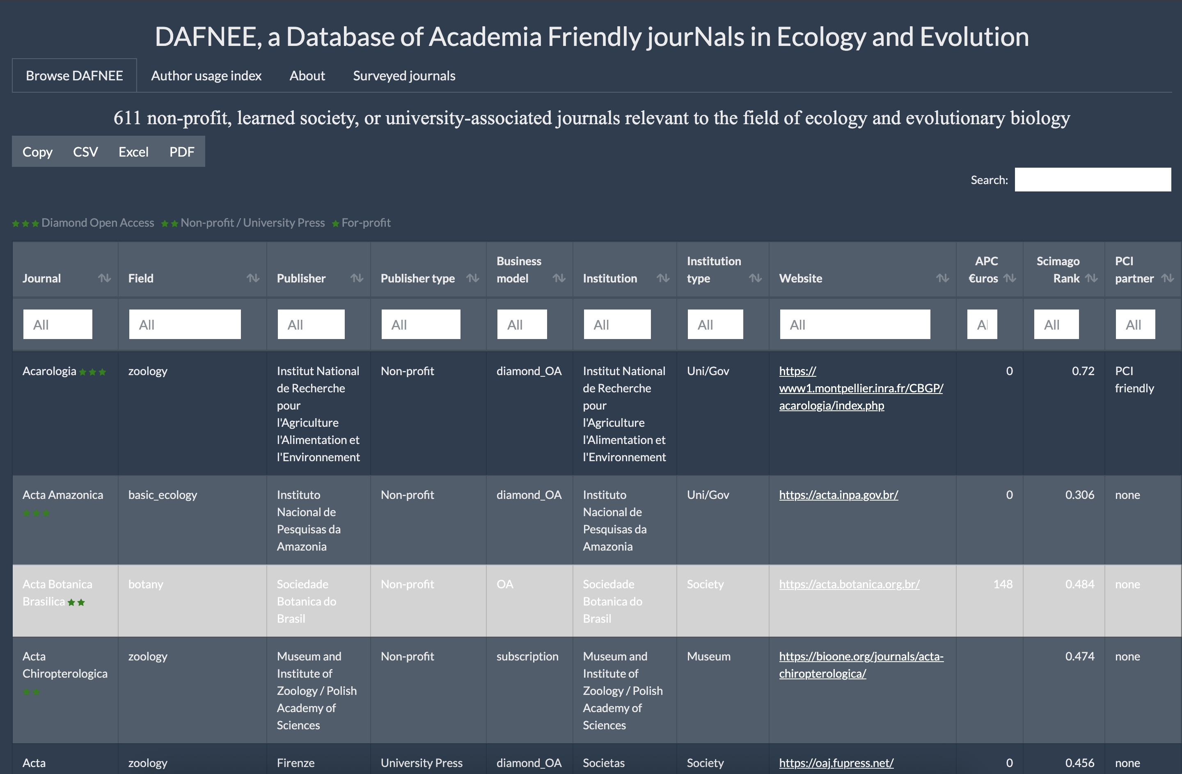
Choosing a journal for your service
Notes:
If those are your shared goals, then how do you find journals that meet your goals?
Here are three resources (tailored toward biogeography, ecology, evolution, though some work for any discipline, e.g. FOAA)

Slide 32
The journal has a transparent ownership structure, and is controlled by and responsive to the scholarly community.
Authors of articles in the journal retain copyright.
All articles are published open access and an explicit open access licence is used.
Submission and publication is not conditional in any way on the payment of a fee from the author or its employing institution, or on membership of an institution or society.
Any fees paid on behalf of the journal to publishers are low, transparent, and in proportion to the work carried out.
https://fairoa.org/
Notes:
The criteria seem generally good … but
- Who are members?
- What activities do they support?

Slide 33
Galtier, N., et al. (2025)
Time to publish ethically: DAFNEE, a database of academia-friendly journals in ecology and evolutionary biology.
J. Evol. Biol. voaf143, https://doi.org/10.1093/jeb/voaf143
https://dafnee.isem-evolution.fr/

Slide 34
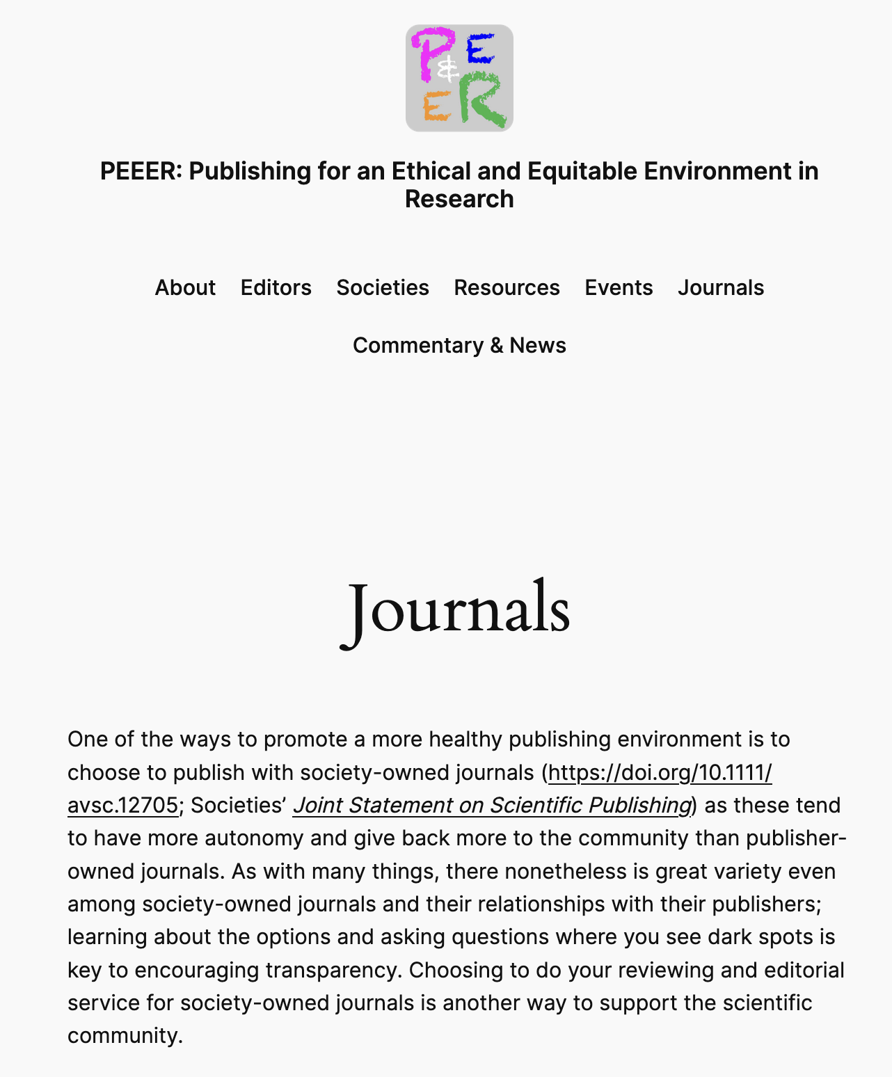
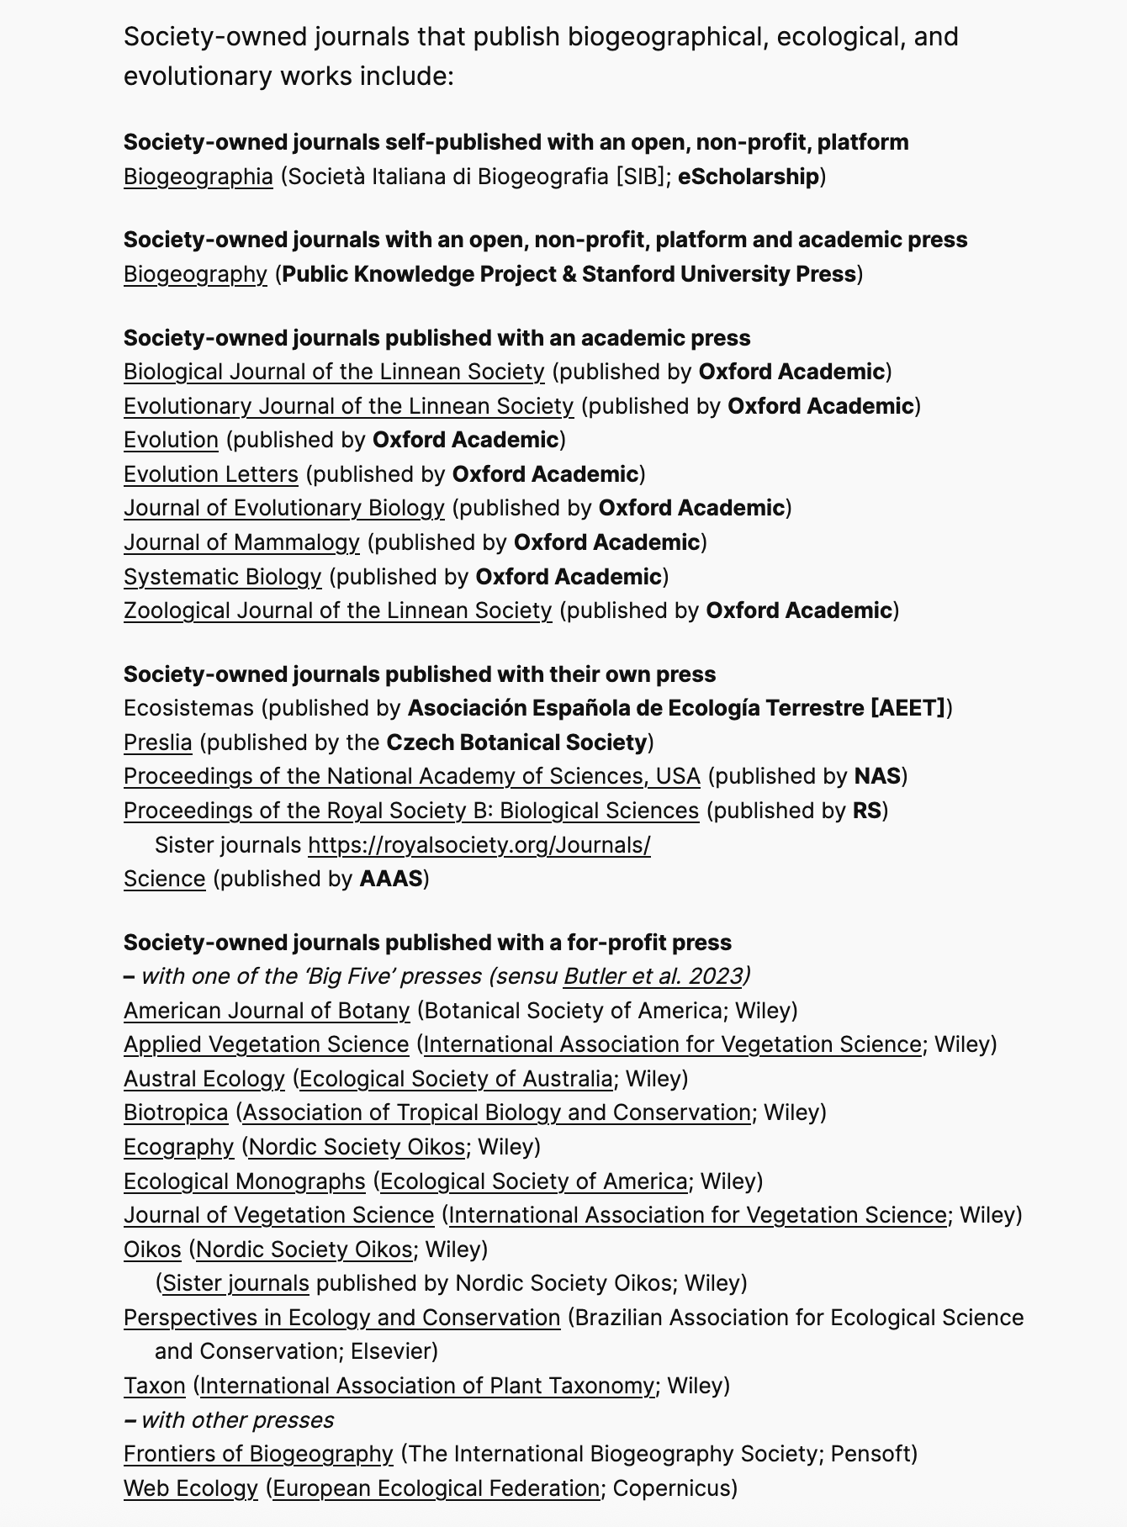

https://peeer.net/journals/
Notes:
PEEER maintains a list of society-owned journals that publish biogeographical work at
https://peeer.net/journals/

Slide 35




A simple rule-of-thumb? Societies and …
Free Association
Biogeographers
o f
Notes:
Oftentimes, a shorthand for finding a suitable journal is to look for society journals
These examples from biogeography, ecology, evolution – most of these, and some others, have signed on to the PEEER Society Joint Statement https://peeer.net/societies/

Slide 36

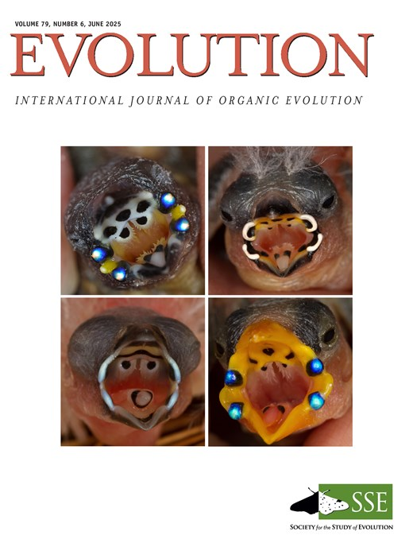
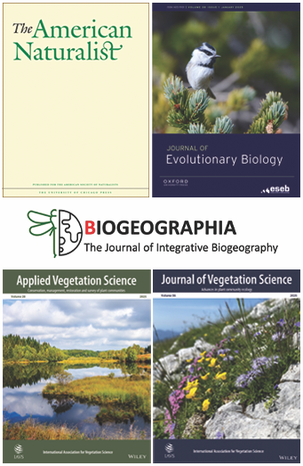
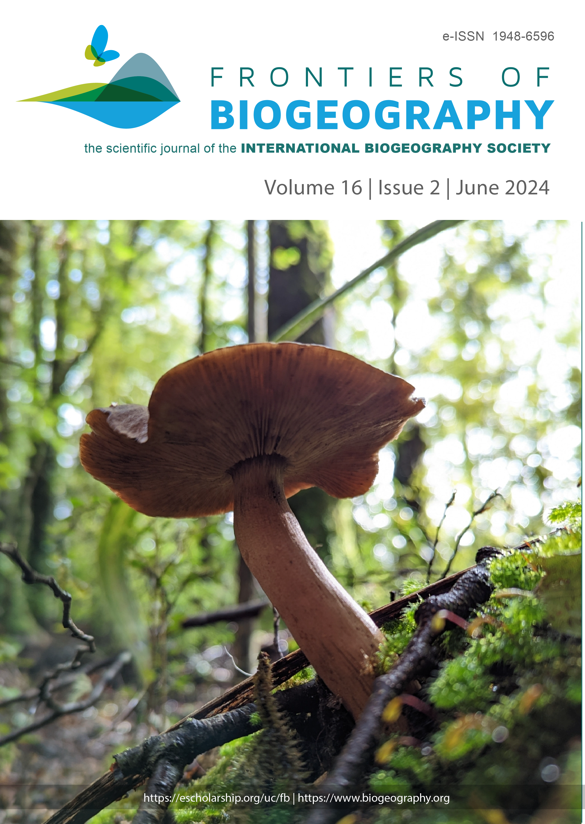


… society journals?
Notes:
These are their journals

Slide 37
Additional benefits
Edited and reviewed by colleagues and potential mentors
Expert review
Rigorous review
… but some caveats
- some ‘society’ journals owned by (for-profit) publishers
- others still support for-profit publishers, e.g. Wiley
- these risks will increase
… responsibilities
- Responsibilities as editors
- https://peeer.net/editors/
https://peeer.net/journals/
Notes:
They come with added benefits for members and early career researchers …
… but beware that it is not a hard-and-fast rule. Moreover, as the community shifts its allegiances toward society journals, for-profit publishers are likely to adjust their positions to once again exploit the community. So, in the future it may be necessary to watch out for publisher-owned societies, society-owned journals in name only, etc.
Editors of these journals also developed the peeer guidance on responsibilities as editors (intended to complement COPE and similar)

Slide 38
Understanding
the
process
Making
informed
recommendations
Helping authors navigate the process
Six key responsibilities irrespective of journal
Keeping
track of
time
Being constructive; give breaks where breaks due; or tough love.
Grow,
mentor &
move on
Notes:
So, once you have chosen a journal for your service, what are your immediate responsibilities as a reviewer/editor. Here is an incomplete list of six recommendations, based on the experiences of a suite of PEEER, reviewers, and editors …
Making informed recommendations ––– as reviewer – be fair, knowledgeable, objective; as editor – including adjudications.
Being constructive –––– as reviewer – honest, constructive, helpful; as editor – frank, positive, instructive, write to Reviewer if review not; (cannot change without permission)

Slide 39
Understanding
the
process
Making
informed
recommendations
Helping authors navigate the process
Six key responsibilities irrespective of journal
Keeping
track of
time
Being constructive; give breaks where breaks due; or tough love.
Grow,
mentor &
move on

Slide 40
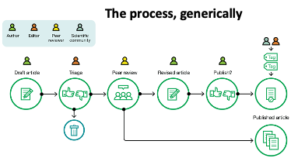
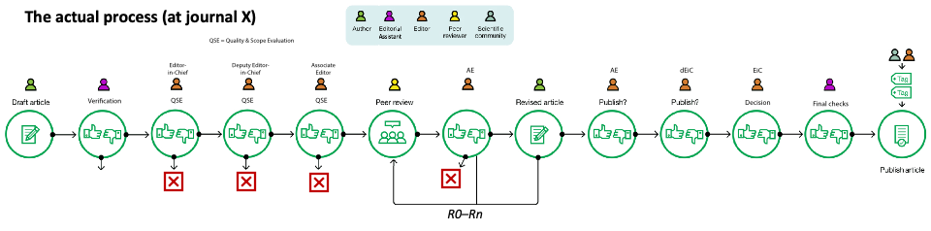

Understanding the Process
Graphically speaking … what is the process for handling manuscripts?
The process, generically
‘predatory’
Pre-prints
$?
$
PCI
Let’s unpack this a little!
Notes:
Journal processes are structured in a variety of ways … associated with different levels of rigor in the process.

Slide 41
Understanding the Process
i.e. only after scope
has been assessed
REVIEWING for core/traditional model
Reviews are
invited here!
Do:
Assess match with your expertise
- need not be expert in all aspects
Respond yes/no; how you can review
- request extension if needed
Review components to your level of expertise
Be clear, constructive; ok to be Frank (not Kurt)
Do review in the requested time, or earlier! :-)
Re-review if requested
Respect confidentiality
Don’t:
Make ad hominem comments
Penalize language, as long as the science is understandable
Be (unnecessarily) discouraging
Say accept/reject, or comment on fit with scope
Notes:
Note, this is specific to REVIEWING
N.B. #4 in the “Do” list is a play on words, specifically a play on the meaning of words that are also names (frank, curt)
You can work through the lists, or highlight a few, ask for discussion on some … however you want to do it, just be mindful of time and balance among sections.

Slide 42
Understanding the Process
Instructions for Reviewers: Reviews should be constructive, polite; the critique honest, based on credible science; they may be frank, but ad hominem comments are unwarranted and must be avoided. Artificial Intelligence must not be used to prepare the review.
1. Summary of the intent of the study and relevance of major findings (~50 to 150 words): the disciplinary / theoretical context, main question(s), principle approaches main conclusions and their importance
2. Major Strengths and/or Weaknesses: conceptual gaps, logic, study design, innovation, overall presentation of the argument and evidence; Strengths, Weaknesses
3. Therefore, suitability of the manuscript for Biogeography (~50 words): e.g. a high quality manuscript in terms of scientific content, writing, and preparation of figures and tables? Or unsuited due to substantial errors, poor study design or execution, insufficient analyses, inadequate preparation? Emphasize why.
If your assessment is that the manuscript is scientifically weak, lacks originality, or has potential but was poorly prepared by authors, there is no need to continue with further review. If the manuscript is, in your opinion, of suitable quality and topic for the journal, we would appreciate additional detailed comments.
4. Minor comments: e.g. list (with line numbers) of areas that lack clarity, have typos or errors in grammar, or otherwise need line edits
Please declare any potential conflicts of interest. If uncertain, contact the handling editor before review.
Notes:
This is our guidance from Biogeography (owned by FAB, published by SUP, using PKP platform)
We have developed them to be simple, to help folk manage their time, and based on our understanding of what is most useful to handling ediors

Slide 43
Understanding the Process
i.e. only after scope
has been assessed
EDITING for core/traditional model
Reviews are
invited here!
On assignment:
On receipt of reviews:
Assess match with your general expertise
- you can get specific expert from reviewers
Assess fit with journal’s scope
Evaluate quality, novelty of study/manuscript
Invite reviewers / make editorial recommendation
Give reviewers cues if you’ve specific questions
Thoroughly read mst, review(s)
Synthesize your and reviewers’ assessments
- highlight themes
- contact reviewer if needed (rare: update review)
Finalize recommendation (maj/min, SWO)
Recommend accept/revise/reject
Notes:
Note, this is specific to EDITING
You can work through the lists, or highlight a few, ask for discussion on some … however you want to do it, just be mindful of time and balance among sections.

Slide 44
Understanding
the
process
Making
informed
recommendations
Helping authors navigate the process
Six key responsibilities irrespective of journal
Keeping
track of
time
Being constructive; give breaks where breaks due; or tough love.
Grow,
mentor &
move on

Slide 45
Helping authors navigate the process
For new authors, the process can be a bit of a black box
Respond
to reviews
& editors
Prepare
mst
Check
proofs
Notes:
These are the typical three points of contact that authors have with the journal. The rest is largely if not completely opaque, at least to early career authors (and reviewers).

Slide 46
Helping authors navigate the process
It’s ok for editors to demystify it …
Workshops:
explain the process, and
broad context
Workshops:
advise how to prepare a
nice mst
Decision guides how to respond constructively
to reviews & editors
If the decision is delayed,
author write to the editor!
Answer pre-submission enquiries: scope, process, expectations, alternatives
Reviewers: ask for clarification
Explain next steps

Slide 47
Understanding
the
process
Making
informed
recommendations
Helping authors navigate the process
Six key responsibilities irrespective of journal
Keeping
track of
time
Being constructive; give breaks where breaks due; or tough love.
Grow,
mentor &
move on

Slide 48
Keeping track of time
Every step takes time, which rapidly accumulates
Prepare
nice mst
Author: If decision delayed,
write to ask the editor!
AE: keep an eye on clock
months
days
days
days
days
weeks
days
weeks–
months
days
days
days
days
weeks
This goes quicker if the manuscript is interesting & well-presented!!
often adds most time!
Notes:
All steps take time. Delays in each rapidly accumulate into undesirable, lengthy, delays.
(Even so, the thing that adds most time is author revisions.)
Strategies to manage the time:
Automated email reminders
Personalized email reminders (probably more effective)
Paper tracker
Can reduce some steps – e.g. one-less Editor step, reduce # rotations for review, …

Slide 49
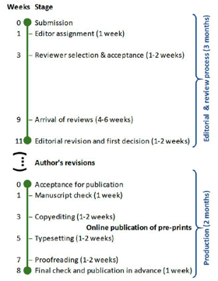
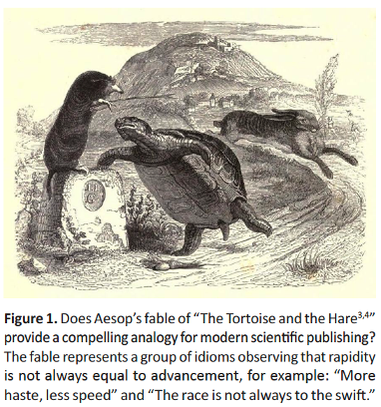
Keeping track of time
‘slow publishing’
Hortal et al. (2019) Slow publishing in the age of ‘fast-food’. Frontiers of Biogeography 11: e44213
adds most time … and wears out people!
Notes:
(That is one reason for the increase in “reject & resubmit” decisions – allows journals to manage their statistics on time from submission to publication. Also explains why journals often focus on time from submission to first decision … which is also kept down by desk rejects.)
Figure 2 caption: Approximate times for all the stages of an editorial process following a slow publishing model, where reviewers and editors are given enough time to constructively critique a manuscript and contribute to the scientific debate. Note that, if the rules of slow publishing are followed, and good-quality reviews and revisions are sought, ideally there may be just one round of author revisions, thus avoiding repeated cycles of the editorial and review process. Times are deliberately given in weeks rather than days, to highlight that the editorial tasks need to be fitted into the work schedules of authors, reviewers, editors, copyeditors and typesetters.

Slide 50
Keeping track of time
How long to spend reviewing?
First pass – skim read the mst / figures; higher level assessment in the aggregate: did you learn something new, is it supported by the data, are the methods appropriate?
If no (manuscript is scientifically weak, lacks originality, or has potential but was poorly prepared by authors), there is no need to continue with further review.
Prepare a review summarizing goals, strengths, major weaknesses. Goal: help authors find direction.
If yes, do a second pass – more detailed read: could the authors add context, are there additional or alternative analyses, what are the strengths and weaknesses of the methods; advise how to improve the impact of the research? What minor edits (including typos, grammatical improvements, figure details, etc) could improve presentation.
Prepare a review summarizing goals, major/minor strengths, major/minor weaknesses, recommend improvements, list typos etc that, admittedly, are difficult for authors to catch after n^{th} read-through.
Goal: help authors finalize mst to be accepted after R1.
Notes:
Ways to manage your time as a REVIEWER … and so to manage when you can fit the review into your already busy schedule … and so help contribute to a timely process by fitting it in earlier.

Slide 51
Keeping track of time
How long to spend editing?
First pass
– skim read the cover letter, abstract: does it fit journal’s scope? [5–10 mins] [senior editor]
- if no: reject (explain why)
– skim methods, figures, results: are the fundamentals sound? [10–15 mins] [handling editor]
- if no: reject (offer brief guidance)
– skim intro, discussion: are context, gap, question, hypothesis appropriate? [10–15 mins] [handling editor]
- if no: reject / revise & resubmit
- if yes: request reviews
Second pass
– when reviews in hand (before reading them in detail), read the mst as a reviewer. Make annotations, notes.
– read reviews in detail
– write decision
[1 day] [handling editor]
Prepare a recommendation emphasizing major strengths & weaknesses, areas/approaches for improvement, moderate reviewer comments if warranted. Goal: help authors get mst accepted after R1.
Notes:
Ways to manage your time as an EDITOR … and so to manage when you can fit the review into your already busy schedule … and so help contribute to a timely process by fitting it in earlier.

Slide 52
Understanding
the
process
Making
informed
recommendations
Helping authors navigate the process
Six key responsibilities irrespective of journal
Keeping
track of
time
Being constructive; give breaks where breaks due; or tough love.
Grow,
mentor &
move on

Slide 53
Making informed decisions
For editors, reviewers
Review/Decision should be based on evidence
(in the manuscript [line #s], relevant references, evident/cited experience)
Assessing manuscripts is a group activity – the process is improved by the touch of multiple hands.
Few people are the expert. Be humble, helpful; hedge when appropriate.
Engage authors, reviewers, editors in a constructive dialogue.
Be open to having your mind changed.
Be constructive, helpful. Foster reciprocal feedback wheel of positive change.
(If you’re wrong, the response will likely be constructive too.)
Notes:
This slide is meant to emphasize that while you have a specific role as an editor / reviewer, and we often think of that as a stage in a linear process, the entire process may be improved by thinking of it more as a dialogue, and realizing it is ok to correspond with your immediate partners, i.e. reviewer–handling_editor, handling_editor–chief_editor, to ask for advice, guidance, thoughts.
The only folk who cannot be engaged in this informal part of the process is the authors – must wait for the formal decision to avoid apparent conflicts of interest, to help manage your and their time, and to keep the decision process ‘clean’

Slide 54
“Peer review is dysfunctional”: Challenges (and a fact-check)
There has been, and is continued perception of, gender bias
Many have experienced being singled out for language (oftentimes clumsily)
Adequate but old technology, may be frowned upon; other limitations may not be understood (e.g. safety)
We have all had bad experiences with peer review / editors
But …
Peer review, is less biased than often perceived (see Squazzoni et al. 2021; Ceci et al. 2023).
When done well, it is constructive, provides opportunity, and is mostly consistent & predictable (single blind).
And variations (e.g. double-blind) give perception of even more impartiality.
Notes:
This slide is intended to reduce the perception that the *entire* system is broken, and to narrow in on what parts of which processes are more/less in need of attention.
This is not to minimize the issues, nor to say peer review is error-free — it is (currently) an human endeavor — but that we need to evaluate the pros-and-cons, to not ‘throw out the baby with the bathwater’, and to work on fixing bad things in ways that don’t break good things.
Need to separate out issues with the peer review process from other factors:
journal policy
cynicism about for-profit publishing
poor processes and/or preparation of reviewers/editors
Intense, multi-faceted pressure faced on academics, limits on time, etc

Slide 55
The editorial/review process is not particularly capricious …
Of manuscripts meeting scope and minimum expectations for preparation:
- 65% of outcomes of peer review correctly predicted by senior editor
- 20% thought possibly unsuitable by senior editor, but given opportunity for review
- 15% thought probably suitable by senior editor on preliminary read-through, but rejected after deeper-dive by AE and/or following review
Notes:
These are some statistics that one of us collected while working as a chief editor, reading all manuscripts that were submitted, and keeping an informal record of which we thought would end up being published or not. The main point is that most manuscripts were predictable (i.e. EIC, AEs, & reviewer opinions were aligned), and that everything else here at least got the chance to be considered at various levels.
Note that the ones on the axes are a few that for one reason or another ended up being given a next stage of consideration by accident / appeal
Note also that this does not consider msts that the EiC desk rejected and that could, perhaps, have gone on to be successful, but we consider this to be a relatively low probability as EIC desk-rejects were generally poor quality, out-of-scope, or otherwise substantially flawed (e.g. insufficient sample sizes).

Slide 56
Understanding
the
process
Making
informed
recommendations
Helping authors navigate the process
Six key responsibilities irrespective of journal
Keeping
track of
time
Being constructive; give breaks where breaks due; or tough love.
Grow,
mentor &
move on

Slide 57
Being constructive; give breaks where breaks due; or tough love.
Be constructive
- Overall better
Give breaks
Sometimes ECRs don’t get good advice / lessons from their profs
Tough love
Easy route is to give a chance … but can lead to many cycles
Always temptation to be helpful … sometimes need to give tough love, with plenty of detail
It’s authors’ responsibility to prep a solid mst (none of this ‘submit for review, cause always something to chance’ bs
Notes:
Being constructive should lead to a positive feedback loop of constructive interactions.
Tough love – you want to identify early on if a manuscript is heading toward 4+ rounds of review, which is painful and unproductive for everyone. Better in those cases to give an early reject (with resubmission).

Slide 58
Understanding
the
process
Making
informed
recommendations
Helping authors navigate the process
Six key responsibilities irrespective of journal
Keeping
track of
time
Being constructive; give breaks where breaks due; or tough love.
Grow,
mentor &
move on

Slide 59
Editors and Reviewers
We are colleagues, authors too, and support good science, generously … let’s build the ranks
GROW:
We are ignorant of much outside our immediate expertise, fallable … and life-long learners
- Reviewing / editing is a great way see different approaches, contemplate them, to learn about process, to practice humility, to improve ourselves as researchers (and so improve the process)
MENTOR:
We are authors … with some particular insight into process to share
- Reviewing / editing is a great way to share the fruits of our labors
- So it’s also a great opportunity to mentor (explicitly/implicitly) colleagues who are us a few years ago
MOVE-ON:
Reviewing is not the end of the road … nor being a handling editor … or senior editor … or editor-in-chief …
- moving on / moving up allows you to keep growing, keep mentoring, meet goals for advancement to more senior ranks, and to also grow the community …
We need more, better, reviewers and editors … especially those familiar with tensions in the ecosystem

Slide 60
… plus …
Some additional strategies:
Get experience as an editor
be a good reviewer
look for editorial academies
let the Editors/Editor-in-Chief of your journal know you’re interested in editing
write to editors to ask about opportunities
Become an Associate Editor
contact senior editors (after publishing multiple articles, and reviewing: quality, timely, constructive)
may have an ‘academy’ or Early Career Research board
Choose the right journals for all your activities (established, society, sustainable diamond OA)
Beware glorified ‘editorial boards’ that are really just reviewing, ‘special issues’, …
Ask your society what opportunities they have!

Slide 61


AGENDA
Intro (10 mins)
Panel Discussion (50 mins)
- short break (5 mins)
Breakout Groups (55 mins)
- short break (5 mins)
Tips for success: reviewers, editors (25 mins)
Q&A (25 mins)
Closing remarks
Q
&
A

Slide 62

AGENDA
Intro (10 mins)
Panel Discussion (50 mins)
- short break (5 mins)
Breakout Groups (55 mins)
- short break (5 mins)
Tips for success: reviewers, editors (25 mins)
Q&A (25 mins)
Closing remarks
WRAP
UP!

Slide 63
GOALS
Share experiences with reviewing and editing as ECRs, and discuss ways to deliver a constructive, quality, timely, process.
To better understand the structure of scientific publishing, including changes in recent decades, journal mechanics, and positive alternatives.
Be positioned to expand your career through meaningful community service as a reviewer and editor.
Meet some new colleagues to hang out with over the coming days!
Notes:
Reflect on the ways that you’ve achieved these goals during the workshop

Slide 64
Take-home messages
Editors are first and foremost people, researchers, authors
Editors are here to help (not ‘gatekeepers’) – you can write to them / we can correspond (judiciously).
It’s our responsibility to know the ropes as a reviewer and editor.
Develop a philosophy on authorship, reviewing, editing, publishing!
Notes:
Provide a few additional points for emphasis

Slide 65
OPPORTUNITIES:
PEEER
Sign up https://peeer.net/the-peeer-team/
Offer workshops
Create other resources; share
FAB
Sign up https://freeassociationbiogeography.org/2024/10/10/fab/
Promote the site, ideas, to your colleagues, other societies
BIOGEOGRAPHY https://biog.journals.sup.org/index.php/biog/
Join our review board –
Watch for an Editorial Academy –
BIOGEOGRAPHY.NEWS https://biogeographynews.org/
Highlight others’ work –
Gain some experience editing in lower pressure situation
Build a cross-platform community –
Come chat with us during the meeting … at our table outside, grab us during breaks, etc …
Notes:
Oftentimes this means society journals.

Slide 66

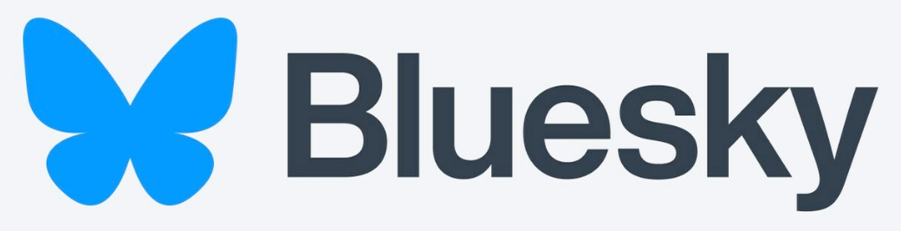

PEEER: Publishing for an Ethical and Equitable Environment in Research
To build a community of authors, editors, reviewers, libraries, publishers, and societies to support affordable and equitable access plus a healthy scientific and research community.
In doing so, to change scientific publishing for the better.
https://peeer.net/
@peeer (https://x.com/peeer295544)
@peeer.bsky.social
@PEEER
#BetterPublishing
peeeresearch@gmail.com
Notes:
Oftentimes this means society journals.
If you are interested to help build community, to change the publishing ecosystem to better support yourself and your colleagues, please consider joining PEEER (for information on how, see https://peeer.net/the-peeer-team/)

Slide 67
Notes:
Blank slide between preparatory notes and any additional slides

