Slide 1
This slide-deck is targeted toward mid-to-late stage graduate students who are submitting/publishing their first-or-second-ish paper and who are interested in and/or will benefit from knowing more about how the publishing process works
Contact PEEER (peeeresearch@gmail.com) with questions or for any additional guidance on content and use.
If you use these resources for a workshop, please send details to peeeresearch@gmail.com so that we can track the use and impact of the resources.
Thank you for supporting #BetterPublishing!

Slide 2
PRE-WORKSHOP
Reminder email to participants (panelists, co-organizers, attendees)
Request to fill in Survey on relevant experience (e.g. how many papers published, career stage, have they reviewed papers, concerns about publishing)
https://docs.google.com/forms/d/e/1FAIpQLSeY3jr5Ym2k4RWxbLTdfTKi5WJlXZiy-nCC1TVjf-gnhLY0Cw/viewform?usp=header
Make Google folder accessible to all for groups to make notes in OR buy large sticky sheet poster sheets (so can display) – SPREADSHEET W/ NAMES & top three options / ‘why’
https://docs.google.com/spreadsheets/d/1-zLcPqdbhtIVwyQoKOq8mDBL3zusmI7qi1fvs-I6s4s/edit?usp=sharing
Make word clouds of any pre-survey / online questions (get R code)
https://simplewordcloud.com/
https://www.freewordcloudgenerator.com/generatewordcloud
https://wordart.com/create

Slide 3
POST-WORKSHOP EMAIL
Thank you email with links to websites, talk slides, contact info, etc, request to complete post-workshop Survey.
Example text:
Dear workshop participants,
Thank you all again for participating in the morning PEEER workshop! We hope you enjoyed the conference and had safe journeys home!
The slide-deck with word clouds is attached.
Here are links to the six tools/guides for exploring journal choices:
Fair Open Access Alliance - https://fairoa.org/
Think.Check.Submit - https://thinkchecksubmit.org/about/
DAFNEE - https://dafnee.isem-evolution.fr/
Journal Targeter - https://jot.publichealth.yale.edu
JANE - https://jane.biosemantics.org
PEEER - https://peeer.net/
The links to the biogeography resources with PEEER are at
Biogeography – https://biog.journals.sup.org/
Biogeography.News – https://biogeographynews.org/
Free Association of Biogeographers – https://FreeAssociationBiogeography.org
Publishing for an Ethical and Equitable Environment in Research (PEEER) - https://peeer.net/
If you would like to learn more about, or get involved in, any of these, please either (1) join the Free Association of Biogeographers and/or PEEER or (2) write to me at mdawson@ucmerced.edu about your interests (e.g. recommending, reviewing, training, ...).
Remember that if you have questions, we and others are here to help answer them.
We would greatly appreciate you completing this short poll about the usefulness (or otherwise) and ways to improve the workshop. https://forms.gle/ZBvnJVMnPucRf9zm7
Good luck with your research, publishing, and reviewing!

Slide 4
Notes:
Blank slide between preparatory notes and the workshop slides

Slide 5


Workshop Series: Successful Biogeography Publishing as Authors, Reviewers, and Editors
Part I: Navigating publishing as a new(ish) author
Presenter
Institution
Presenter
Institution
Presenter
Institution
w/ contributions from: Liz Alter, (CSU Monterey Bay), Mike Dawson (University of California, Merced, USA),
Tom Matthews (Birmingham University, UK), Leticia Ochoa-Ochoa (UNAM, Mexico), Amanda Taylor (Wageningen University, Netherlands), Helena Tukiainen (University of Oulu, Finland), Fabricio Villalobos (INECOL, Mexico),
and members of PEEER
Notes:
Briefly introduce yourselves as developing this workshop, based on the workshop series developed by PEEER (Publishing for an Ethical and Equitable Environment in Research) — a coalition of authors, editors, reviewers, libraries, publishers, and societies to support affordable and equitable access plus a healthy scientific and research community.
Add brief intro = personal journey, if it seems appropriate.

Slide 6
GOALS
Share hopes for, and experiences with barriers to, publishing as ECRs, and discuss ways we can overcome the barriers.
To better understand the structure of scientific publishing, including changes in recent decades, journal mechanics, and possible alternatives.
Be positioned to have greater success in publishing in your first choice journal.
Make some new friends to hang out with over the coming days!
Notes:
Share the goals for the workshop

Slide 7

AGENDA
Intro (10 mins)
Panel Discussion (50 mins)
- short break (5 mins)
Breakout Groups (55 mins)
- short break (5 mins)
Tips for success: authors (25 mins)
Q&A (25 mins)
Closing remarks / Optional: lunch - relocate to Library cafeteria
BIGSTOCK
Notes:
Share the agenda. Timing can be expanded to a four-hour workshop primarily by giving more time for the breakout groups, extending breaks by 5 mins, allowing a little more time for the final Tips & QA sessions. (We encourage interruptions and questions in the Tips session, essentially merging the Tips+QA which leads to a more dynamic discussion.
Edit the final line, depending on your plans. The lunch can offer an opportunity for Workshop 1 participants to mingle with Workshop 2 participants (as well as panelists and organizers) if you are running both workshops consecutively.

Slide 8

AGENDA
Intro (10 mins)
Panel Discussion (50 mins)
- short break (5 mins)
Breakout Groups (55 mins)
- short break (5 mins)
Tips for success: authors (25 mins)
Q&A (25 mins)
Closing remarks / Optional: lunch - relocate to Library cafeteria

Slide 9
Workshop:
WHY: Navigating publishing as a new(ish) author?
22,000
Biogeography
Nature Biodiv. Rev.
Current changes in scientific publishing are among the most radical in >350 years: the digital revolution, more rapidly expanding publishing options, publish-or-perish, ...
BSSB
NPJ Biodiv.
Evol Lett
Nature E&E
DDI
GEB
JEB
# of journals ===>
JBI
Frontiers of
Biogeography
Biogeographia
Syst Biol
# scientific
journals
PTRSL
Am Nat
Evolution
Key:
Society-owned
Publisher-owned
ecology/evolution
biogeography
Notes:
Why are we offering this workshop?
Current changes in publishing [see slide text] … including changing ownership of journals.
From 1655–1960s, almost all journals were owned and run by societies. In recent years (taking root in the 1960s–1990s), the vast majority of new journals have been for-profit publisher-owned, accelerating in the past decade-or-so with predatory publishers, MDPI, Frontiers.in, and cascade journals at all the major publishers.

Slide 10
Workshop:
WHY: Navigating publishing as a new(ish) author?
22,000
Biogeography
Nature Biodiv. Rev.
BSSB
Reviewing
is declining
NPJ Biodiv.
… it is increasingly difficult to get peer reviews ...
Evol Lett
Nature E&E
… will be extinct by 2050!
DDI
GEB
JEB
JBI
Frontiers of
Biogeography
Biogeographia
Syst Biol
# scientific
journals
PTRSL
Am Nat
Evolution
Key:
Society-owned
Publisher-owned
ecology/evolution
biogeography
Dawson, MN (2022) J. Biogeography 50:41-42. https://doi.org/10.1111/jbi.14567

Slide 11
Workshop:
WHY: Navigating publishing as a new(ish) author?
22,000
Biogeography
$12290 Nature / Nature Ecol Evol
Nature Biodiv. Rev.
BSSB
Domestic field season
NPJ Biodiv.
… the costs of publishing are high
and disproportional ...
$ 7030 TREE
Evol Lett
Nature E&E
2 lanes Novaseq X 25B
$ 6075 PNAS
$ 4830 J. Biogeography
$ 3770 DDI/GEB
$ 3640 MPE
1 mo. 50% GSR
DDI
GEB
$~2000 Am Nat, Evol (member)
$ 1400 Frontiers of Biogeogr.
JEB
actual cost
JBI
Frontiers of
Biogeography
Biogeographia Biogeography
Biogeographia
$ 0
Syst Biol
Evolution
# scientific
journals
PTRSL
Am Nat
Key:
Society-owned
Publisher-owned
ecology/evolution
biogeography

Slide 12
… by multiple measures, scientific publishing is in a crisis!
22,000
Biogeography
$12850 Nature / Nature Ecol Evol
Nature Biodiv. Rev.
BSSB
BSSB
NPJ Biodiv.
Reviewing
is declining
Domestic field season
NPJ Biodiv.
$ 7030 TREE
Evol Lett
Nature E&E
Evol Lett
Nature E&E
2 lanes Novaseq X 25B
$ 6075 PNAS
$ 4830 J. Biogeography
$ 3770 DDI/GEB
… will be extinct by 2050!
$ 3640 MPE
DDI
GEB
1 mo. 50% GSR
DDI
GEB
$~2000 Am Nat, Evol (member)
$ 1400 Frontiers of Biogeogr.
JEB
JEB
Frontiers of
Biogeography
actual cost
JBI
Frontiers of
Biogeography
JBI
Biogeographia
Biogeographia Biogeography
Biogeographia
$ 0
Syst Biol
Syst Biol
# scientific
journals
Evolution
# scientific
journals
Am Nat
Evolution
PTRSL
Am Nat
PTRSL
Key:
Society-owned
Publisher-owned
ecology/evolution
biogeography
Key:
Society-owned
Publisher-owned
ecology/evolution
biogeography

Slide 13
Workshop Series: Successful Biogeography Publishing as Authors, Reviewers, and Editors
Part I: Navigating publishing as a new(ish) author
This in-person workshop will discuss strategies for navigating the increasingly complicated publishing landscape, and for being successful.
Activities will seek opportunities for input on these from participating early career researchers and discuss how you would like scientific publishing to evolve to better support the research community in the future.
Notes:
So, this workshop will … [paraphrase slide text]

Slide 14

Principles of Community
We have shared interests in being successful in an improved publishing environment.
In achieving that goal we may have to address inequalities, unfamiliar topics, individual experiences. We ask that everyone listens, learns, and shows respect and understanding.
Congress SAFE Policy: https://www.evolutionmeetings.org/safe-evolution.html
Code of Conduct: https://www.evolutionmeetings.org/policies.html
Notes:
In terms of workshop logistics/tenor, please remember that …[paraphrase slide text]

Slide 15

AGENDA
Intro (10 mins)
Panel Discussion (50 mins)
- short break (5 mins)
Breakout Groups (55 mins)
- short break (5 mins)
Tips for success: authors (25 mins)
Q&A (25 mins)
Closing remarks / Optional: lunch - relocate to Library cafeteria

Slide 16
Panel Discussion - Q & A (50 mins)
Plan:
To share experiences in publishing and a solution to a challenge encountered
Schedule:
Brief self-introduction by panelists
Question & answer session
e.g. motivations to publish, and barriers to publishing
e.g. peer review process
e.g. enacting cultural change
open mic
Break (~15 mins)
Notes:
WARM-UP QUESTIONS IF NEEDED
(Motivations for publishing)
Motivations for publishing: Evaluations? Personal satisfaction?
What are the external pressures experienced when choosing a publishing venue?
How do the current metrics for evaluating research (e.g., impact factor, h-index) affect publishing choices
(Peer review process)
How do journal publishers ensure transparency in their editorial and review processes, and what improvements could be made to increase trust in these processes?
What are the potential benefits and challenges of preprint servers, and how can they be effectively integrated into the publishing landscape?
What role do editors/societies/publishers/librarians play in supporting ECRs through the publishing process, and how can this support be enhanced?
(Enacting cultural change)
What are the main barriers to affordable open access publications, and how can these barriers be reduced?
What initiatives can journals implement to ensure a more equitable and inclusive publishing process for researchers (think globally)?
What strategies can be implemented in different institutions to ensure that researchers from underrepresented regions and institutions have equitable opportunities in the publishing process?
What role could scientific societies play in ameliorating the current situation?
What “we/you” as researchers can do?

Slide 17
Panelists:
Name | Institution, country | Position. Relevant experience.
Name | Institution, country | Position. Relevant experience.
Name | Institution, country | Position. Relevant experience.
Name | Institution, country | Position. Relevant experience.
Notes:
After panelists introduce themselves, during which they might also give a short anecdote of a pivotal experience in publishing themselves, to transition to audience questions you might:
Ask the audience a question or two first, e.g. about how many of them have published a paper, what career stage they’re at, or similar relevant things.
Prepare a few warm-up questions, in case needed
Start the audience questions as soon as possible

Slide 18
5 mins break
*check email for link
needed for the next step
https://docs.google.com/spreadsheets/d/1-zLcPqdbhtIVwyQoKOq8mDBL3zusmI7qi1fvs-I6s4s/edit?usp=sharing
Notes:
Note that this link should be synchronized with the links in the email sent to participants before the workshop (see initial three slides) and with the links on the slides during the breakout sessions.
We usually cue up the email to send a few minutes before the end of the panel session, or during the break (if it’s a longish break).
You may want to extend this break a little, depending on how long you have for the workshop, how long the prior session was, whether you’ve got refreshments, etc …

Slide 19

AGENDA
Intro (10 mins)
Panel Discussion (50 mins)
- short break (5 mins)
Breakout Groups (55 mins)
- short break (5 mins)
Tips for success: authors (25 mins)
Q&A (25 mins)
Closing remarks / Optional: lunch - relocate to Library cafeteria

Slide 20

Breakout activity – Choosing journals (55 min)
Plan:
To think about criteria and strategies for choosing where to publish
Schedule: (3 sections, each about 15-20 mins; think, [pair,] share)
1st section: Where do you and your colleagues publish and read science?
2nd section: Where would you like to publish?
3rd section: What is a good journal in which to publish?
Notes:
A set of questions for workshop participants to answer and discuss, I divided into three discussions. These were the following:
1st section: In which journal(s) are the topics of your thesis being published? Which journal(s) have you read more articles from? Which journal is the most read in your research area/field?
2nd section: Where do you want to publish? Why?
3rd section: What attributes should a "good" journal have? What constitutes a "good journal"?
While we have used the linked google sheet to gather responses, which the lead organizer has pasted into a wordcloud to share. Others have written the answers on a blackboard and fostered a group discussion around them.

Slide 21
Breakout groups (55 mins)
For each section:
Organizational comments; form 4 groups; each group designate a
facilitator, time-keeper, scribe, reporter) (<5 mins)
Think – [Pair –] Share
Discuss prompts (~10 mins)
Shareback (~5 mins)
x2!!
PleaseUseCamelBackText
document for shareback
https://docs.google.com/spreadsheets/d/1-zLcPqdbhtIVwyQoKOq8mDBL3zusmI7qi1fvs-I6s4s/edit?usp=sharing
Notes:
CamelBackText – i.e. word or phrase written as a single string with capitalization marking the start of each word.
Snake_text may also work, but check your wordcloud generator to be sure.

Slide 22
Breakout activity – Choosing journals (55 min)
1st section: Where do you and your colleagues publish and read science?
a. In which journal(s) are the topics of your thesis being published?
b. Which journal(s) have you read more articles from?
c. Which journal is the most read in your research area/field?
d. Which journals do you cite?
2nd section: Where would you like to publish?
3rd section: What is a good journal in which to publish?
PleaseUseCamelBackText
document for shareback
https://docs.google.com/spreadsheets/d/1-zLcPqdbhtIVwyQoKOq8mDBL3zusmI7qi1fvs-I6s4s/edit?usp=sharing

Slide 23
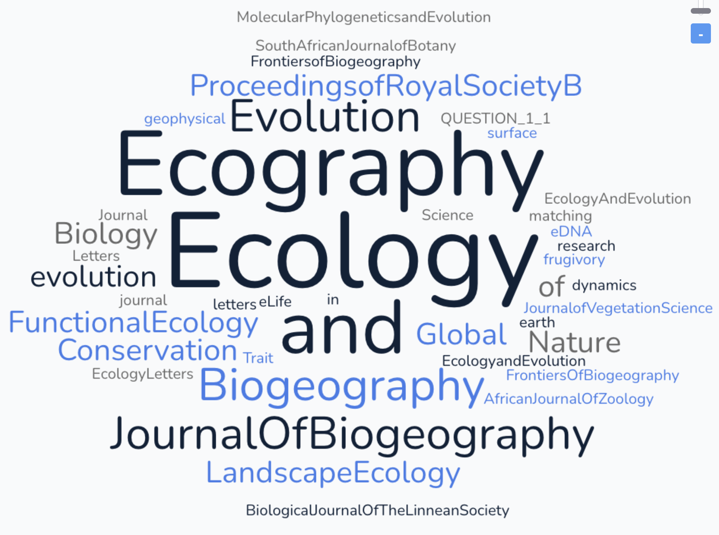
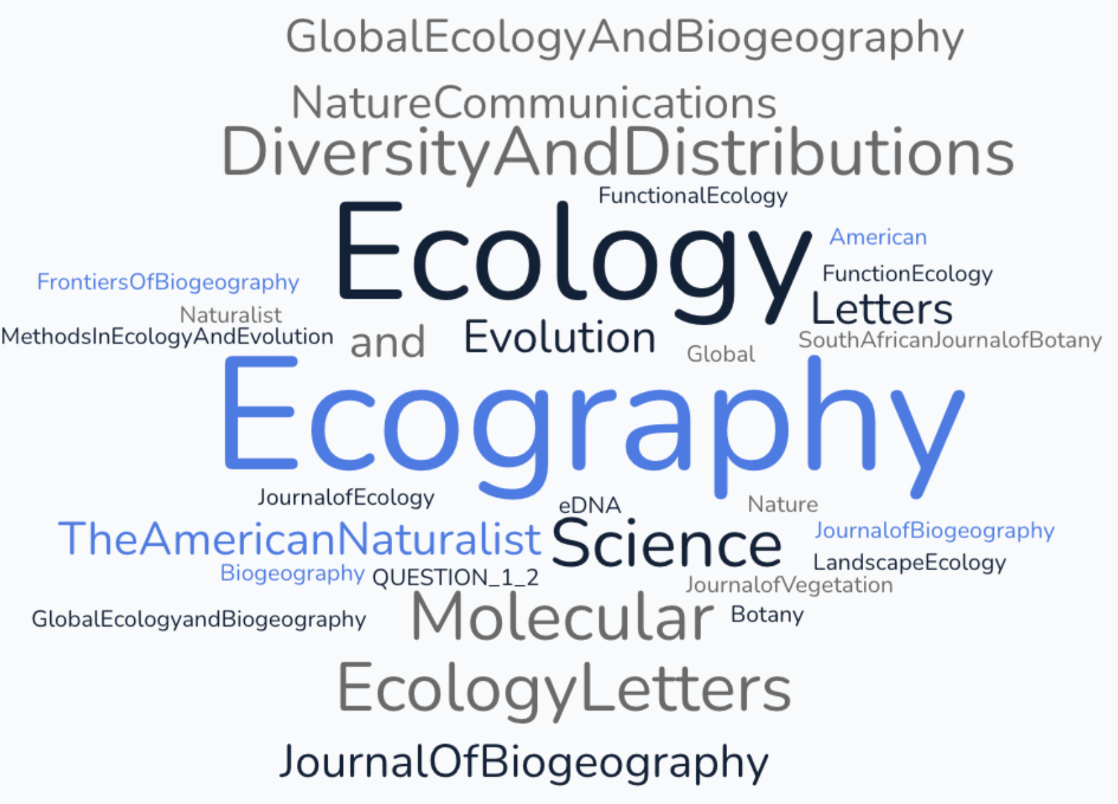
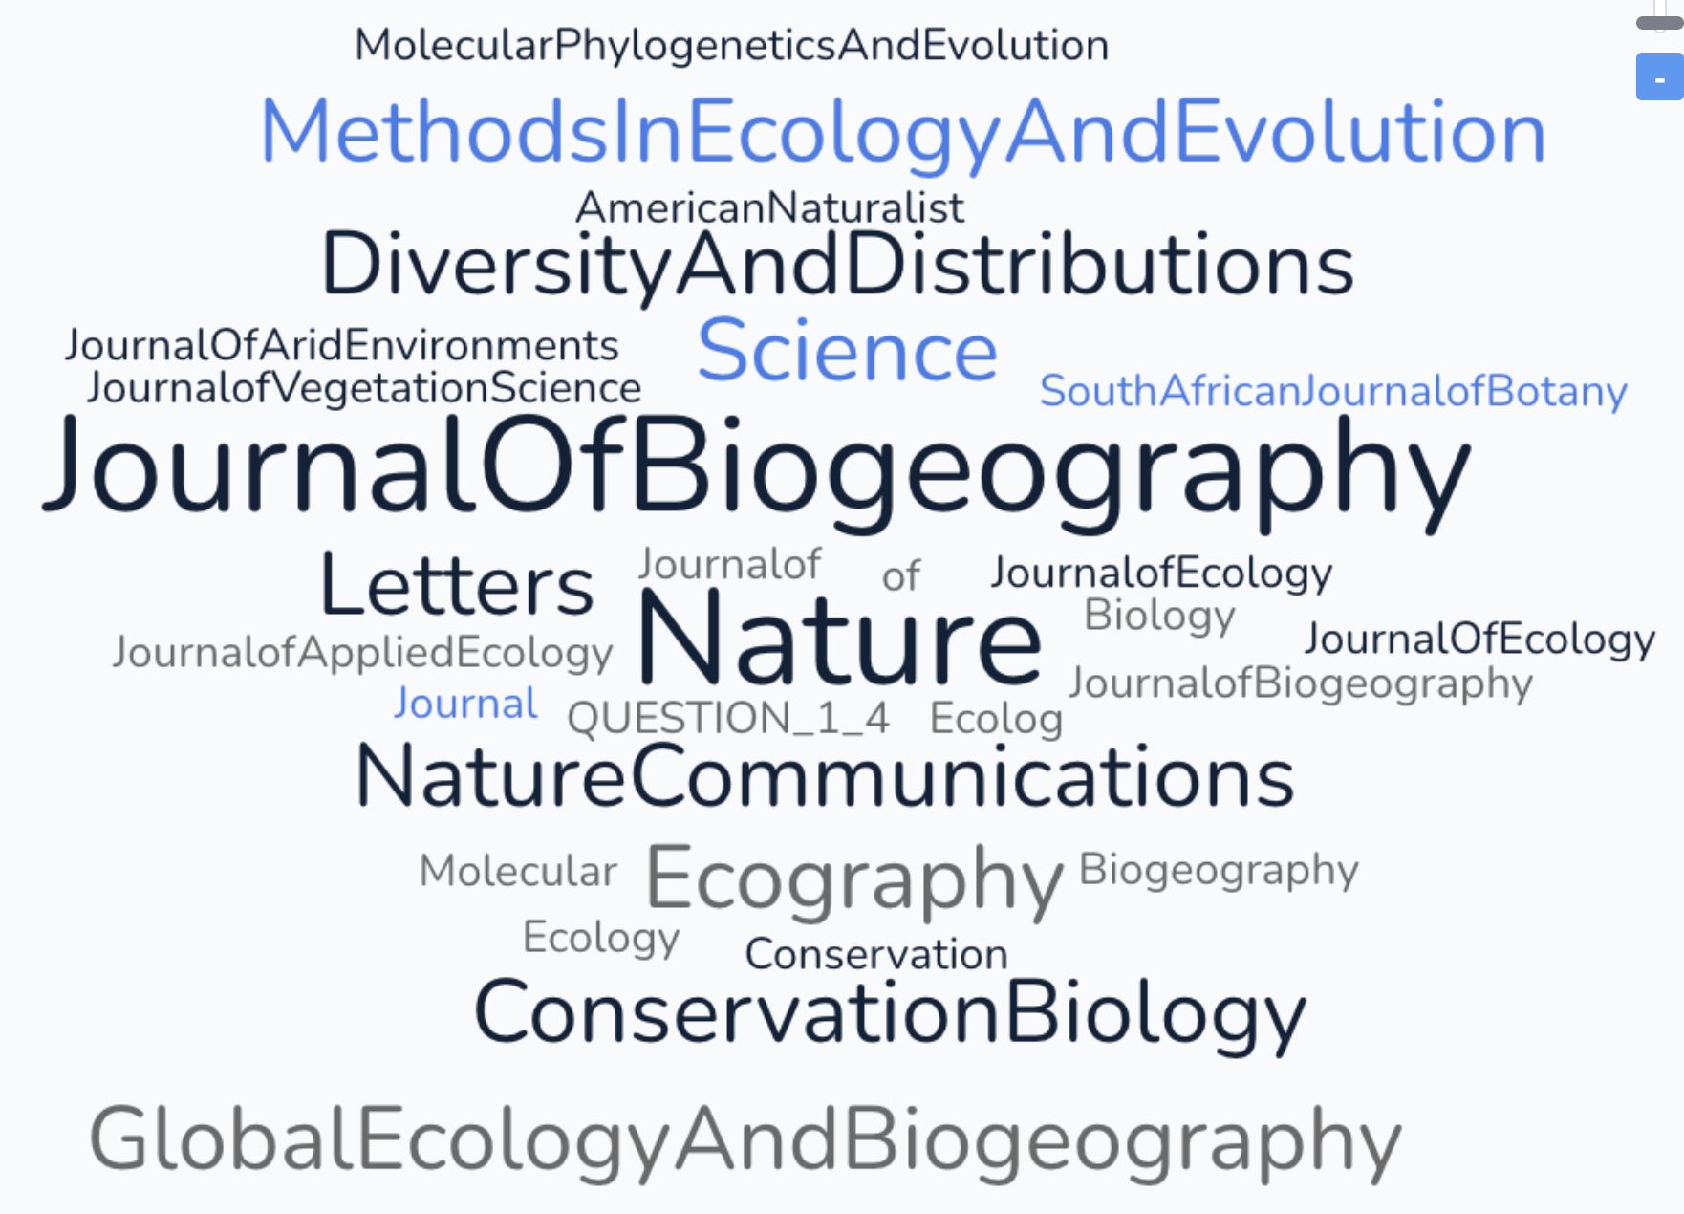
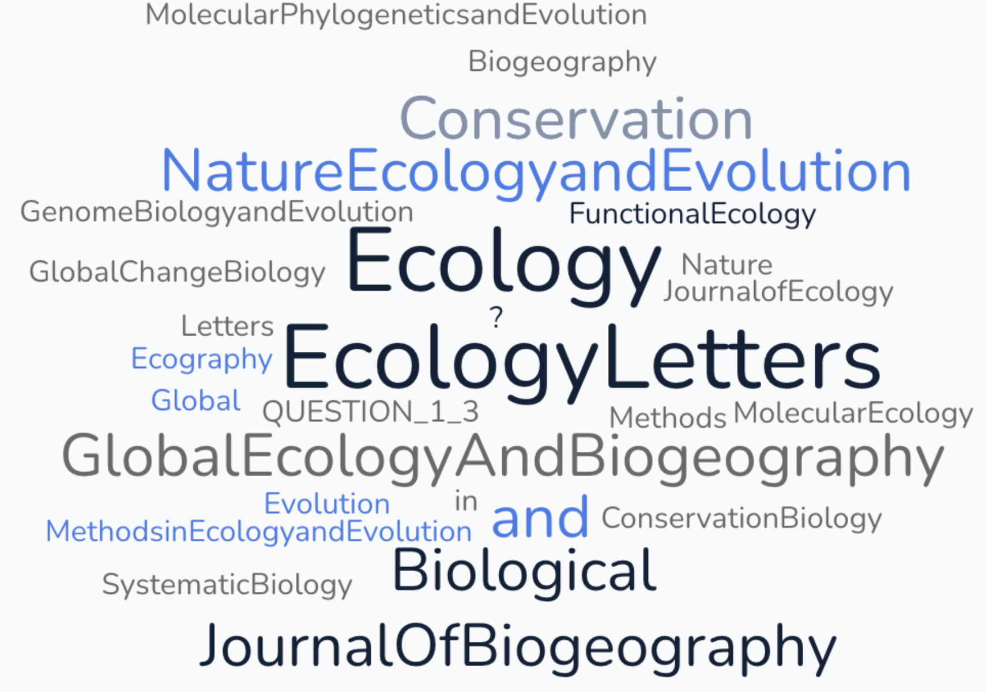
In which journal(s) are the topics of your thesis being published?
Which journal(s) have you read more articles from?
Which journal is the most read in your research area/field?
Which journals do you cite?
Notes:
Before you start the workshop, delete the four wordclouds from this slide. You will generate new wordclouds using the new workshop participants’ input.
During the workshop, we usually just make the wordclouds in the browser (https://simplewordcloud.com/ has proven simple and reliable to date) and show them there, to save time rather than copying and pasting. We add the screenshots later, before sharing a PDF with the workshop participants.

Slide 24
Breakout activity – Choosing journals (55 min)
1st section: Where do you and your colleagues publish and read science?
2nd section: Where would you like to publish?
a. Where do you want to publish?
b. Why?
3rd section: What is a good journal in which to publish?
PleaseUseCamelBackText
document for shareback
https://docs.google.com/spreadsheets/d/1-zLcPqdbhtIVwyQoKOq8mDBL3zusmI7qi1fvs-I6s4s/edit?usp=sharing

Slide 25
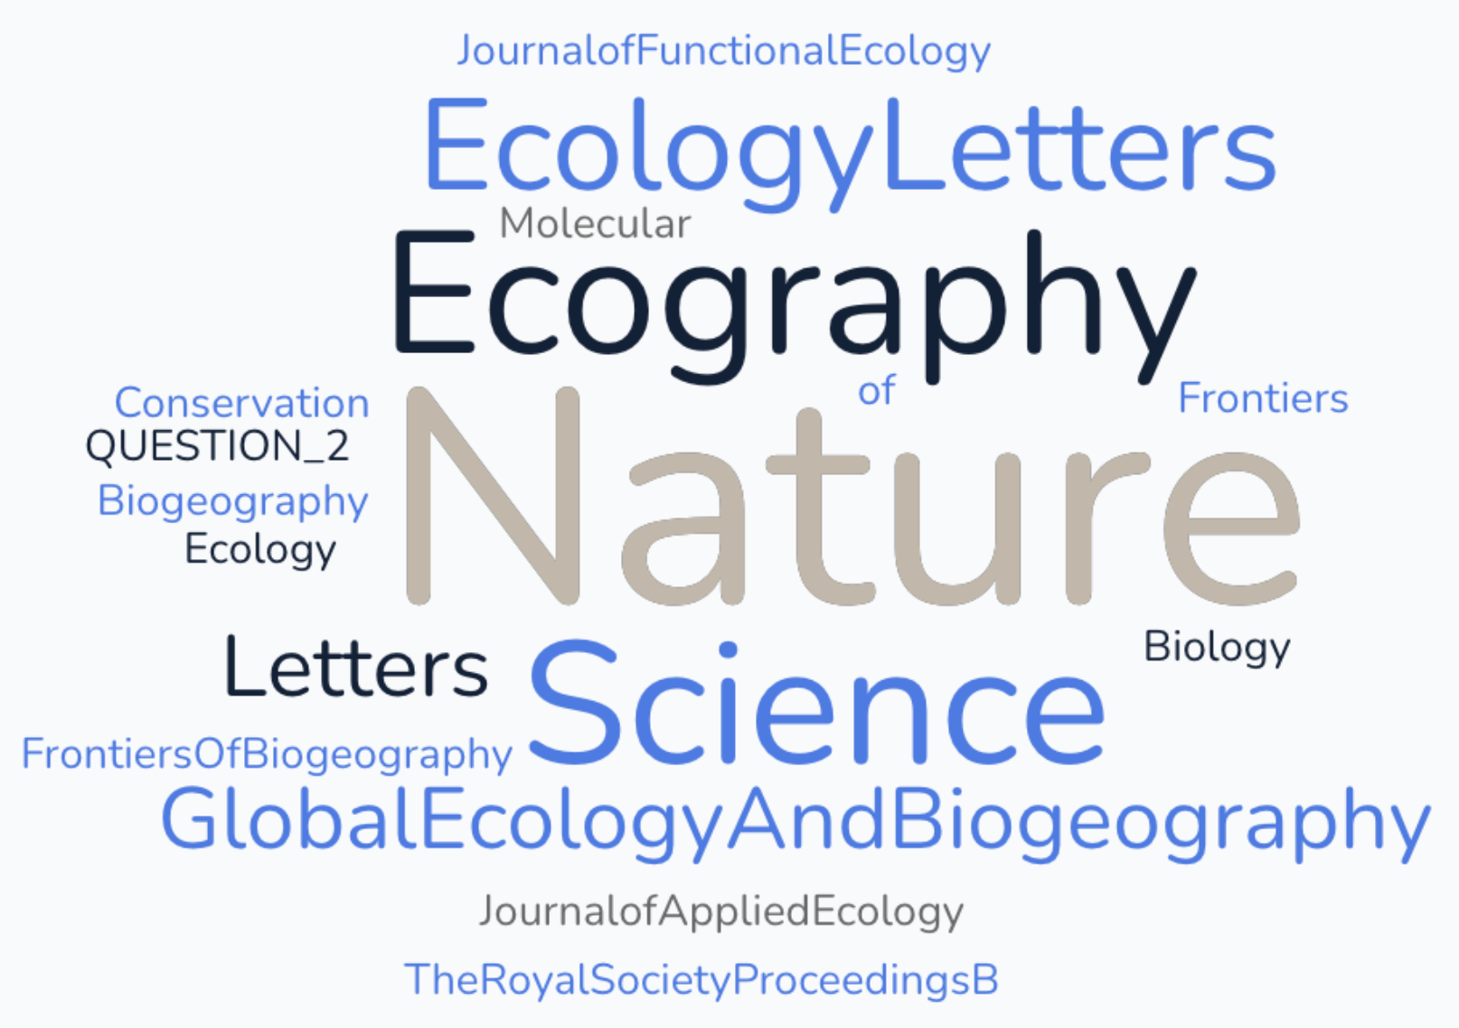
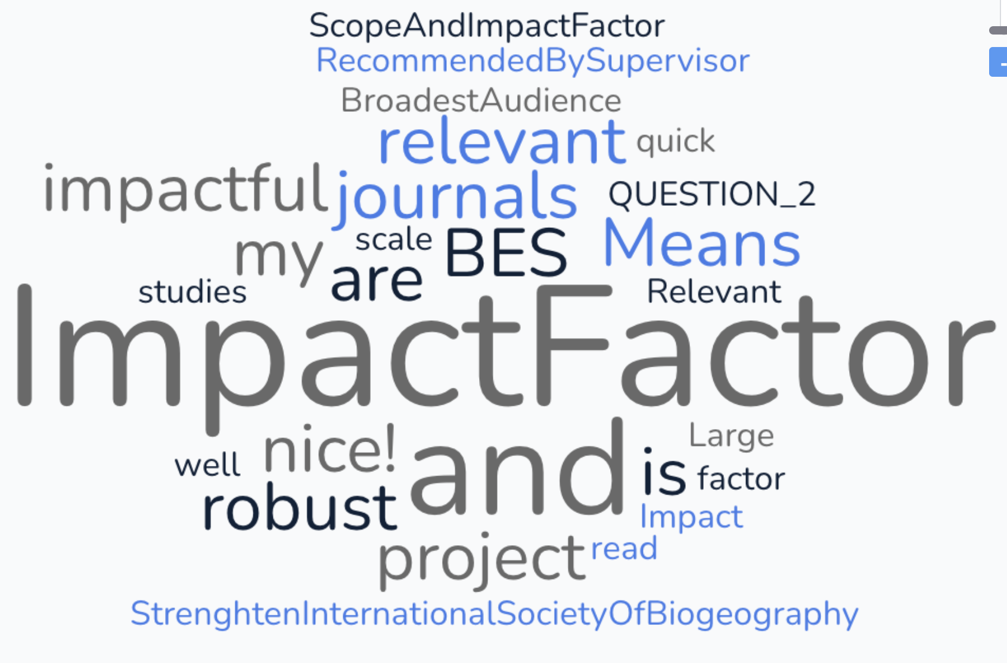
Where do you want to publish?
Why?
Notes:
Before you start the workshop, delete the two wordclouds from this slide. You will generate new wordclouds using the new workshop participants’ input, share them in the browser, and paste them here before distributing the PDF to participants after the workshop.

Slide 26
Breakout activity – Choosing journals (55 min)
1st section: Where do you and your colleagues publish and read science?
2nd section: Where would you like to publish?
3rd section: What is a good journal in which to publish?
What attributes should a "good" journal have?
What constitutes a "good journal"?
PleaseUseCamelBackText
document for shareback
https://docs.google.com/spreadsheets/d/1-zLcPqdbhtIVwyQoKOq8mDBL3zusmI7qi1fvs-I6s4s/edit?usp=sharing

Slide 27
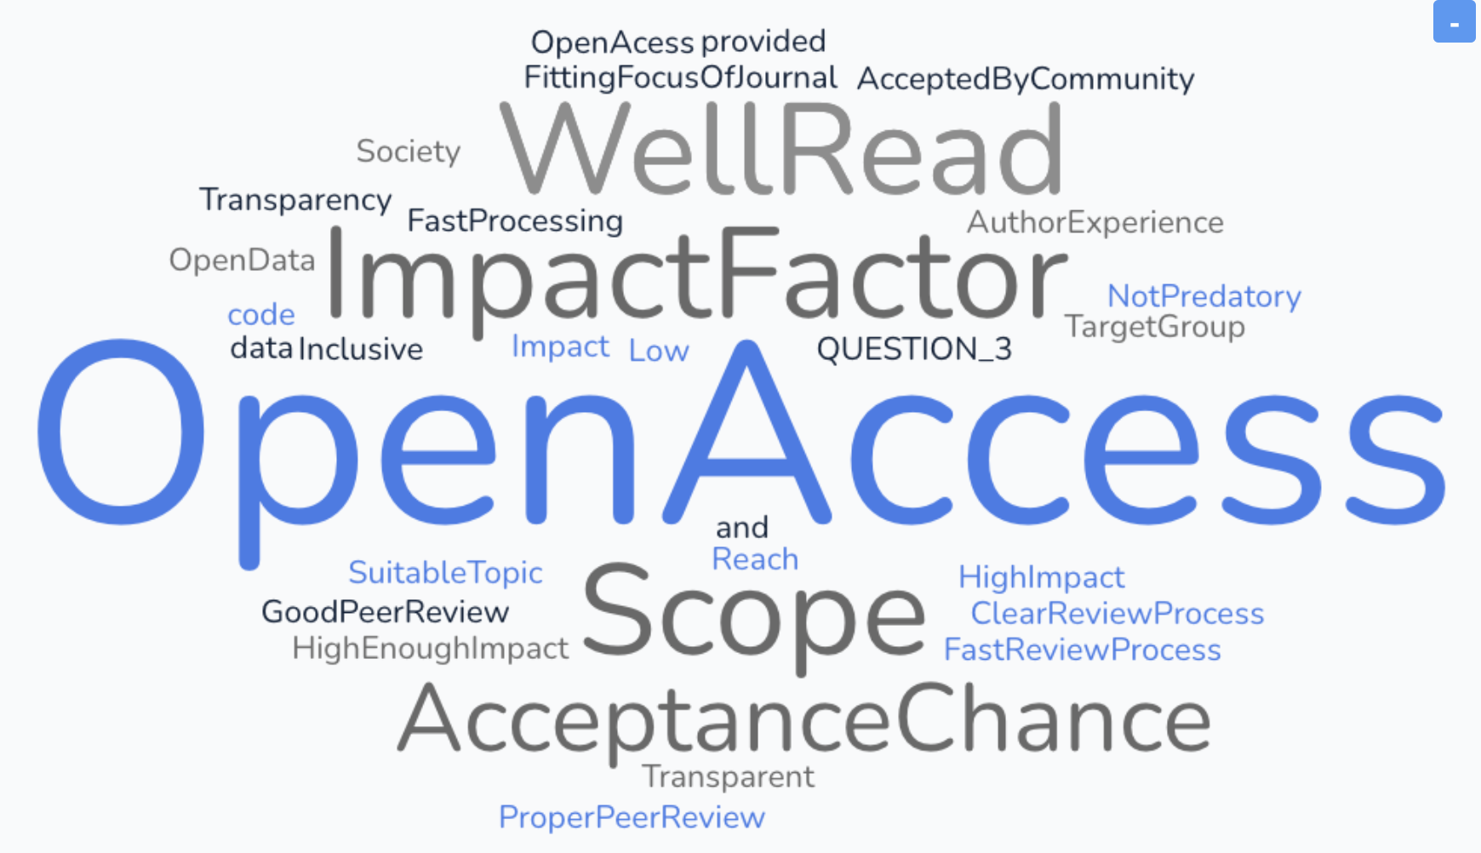
What is a good journal in which to publish?
Notes:
Before you start the workshop, delete the wordcloud from this slide. You will generate new wordclouds using the new workshop participants’ input, share them in the browser, and paste them here before distributing the PDF to participants after the workshop.

Slide 28
Successful Biogeography Publishing
With the preceding discussion in mind, let’s create a definition of success:
What do we not mean by success?
What do we propose it does mean?
This is where we’ll pick up the next Tips and Q&A session …
Notes:
Have the participants either
Think about it themselves during break
Think-pair before break
Think-pair-share and develop a couple of statements for the prompts, e.g. to compare with what we propose after the break.
They can do this in their head, on boards/posterpaper or on an extra tab in the google sheet.

Slide 29
5 mins break

Slide 30

AGENDA
Intro (10 mins)
Panel Discussion (50 mins)
- short break (5 mins)
Breakout Groups (55 mins)
- short break (5 mins)
Tips for success: authors (25 mins)
Q&A (25 mins)
Closing remarks / Optional: lunch - relocate to Library cafeteria

Slide 31
Successful Biogeography Publishing
What we do not mean by success: publishing as much as possible as fast as possible
What we propose it does mean: publishing high quality research in good journals, which support [1] you as an author and [2] the community of which you are a member and so helping you and others be successful and creative/happy (happy & unrushed gives space to be creative) in science.
----------------------+----------------------
Goal: provide perspectives from editors, authors and reviewers on how to increase your success
Notes:
Briefly discuss shared lessons/meaning.

Slide 32
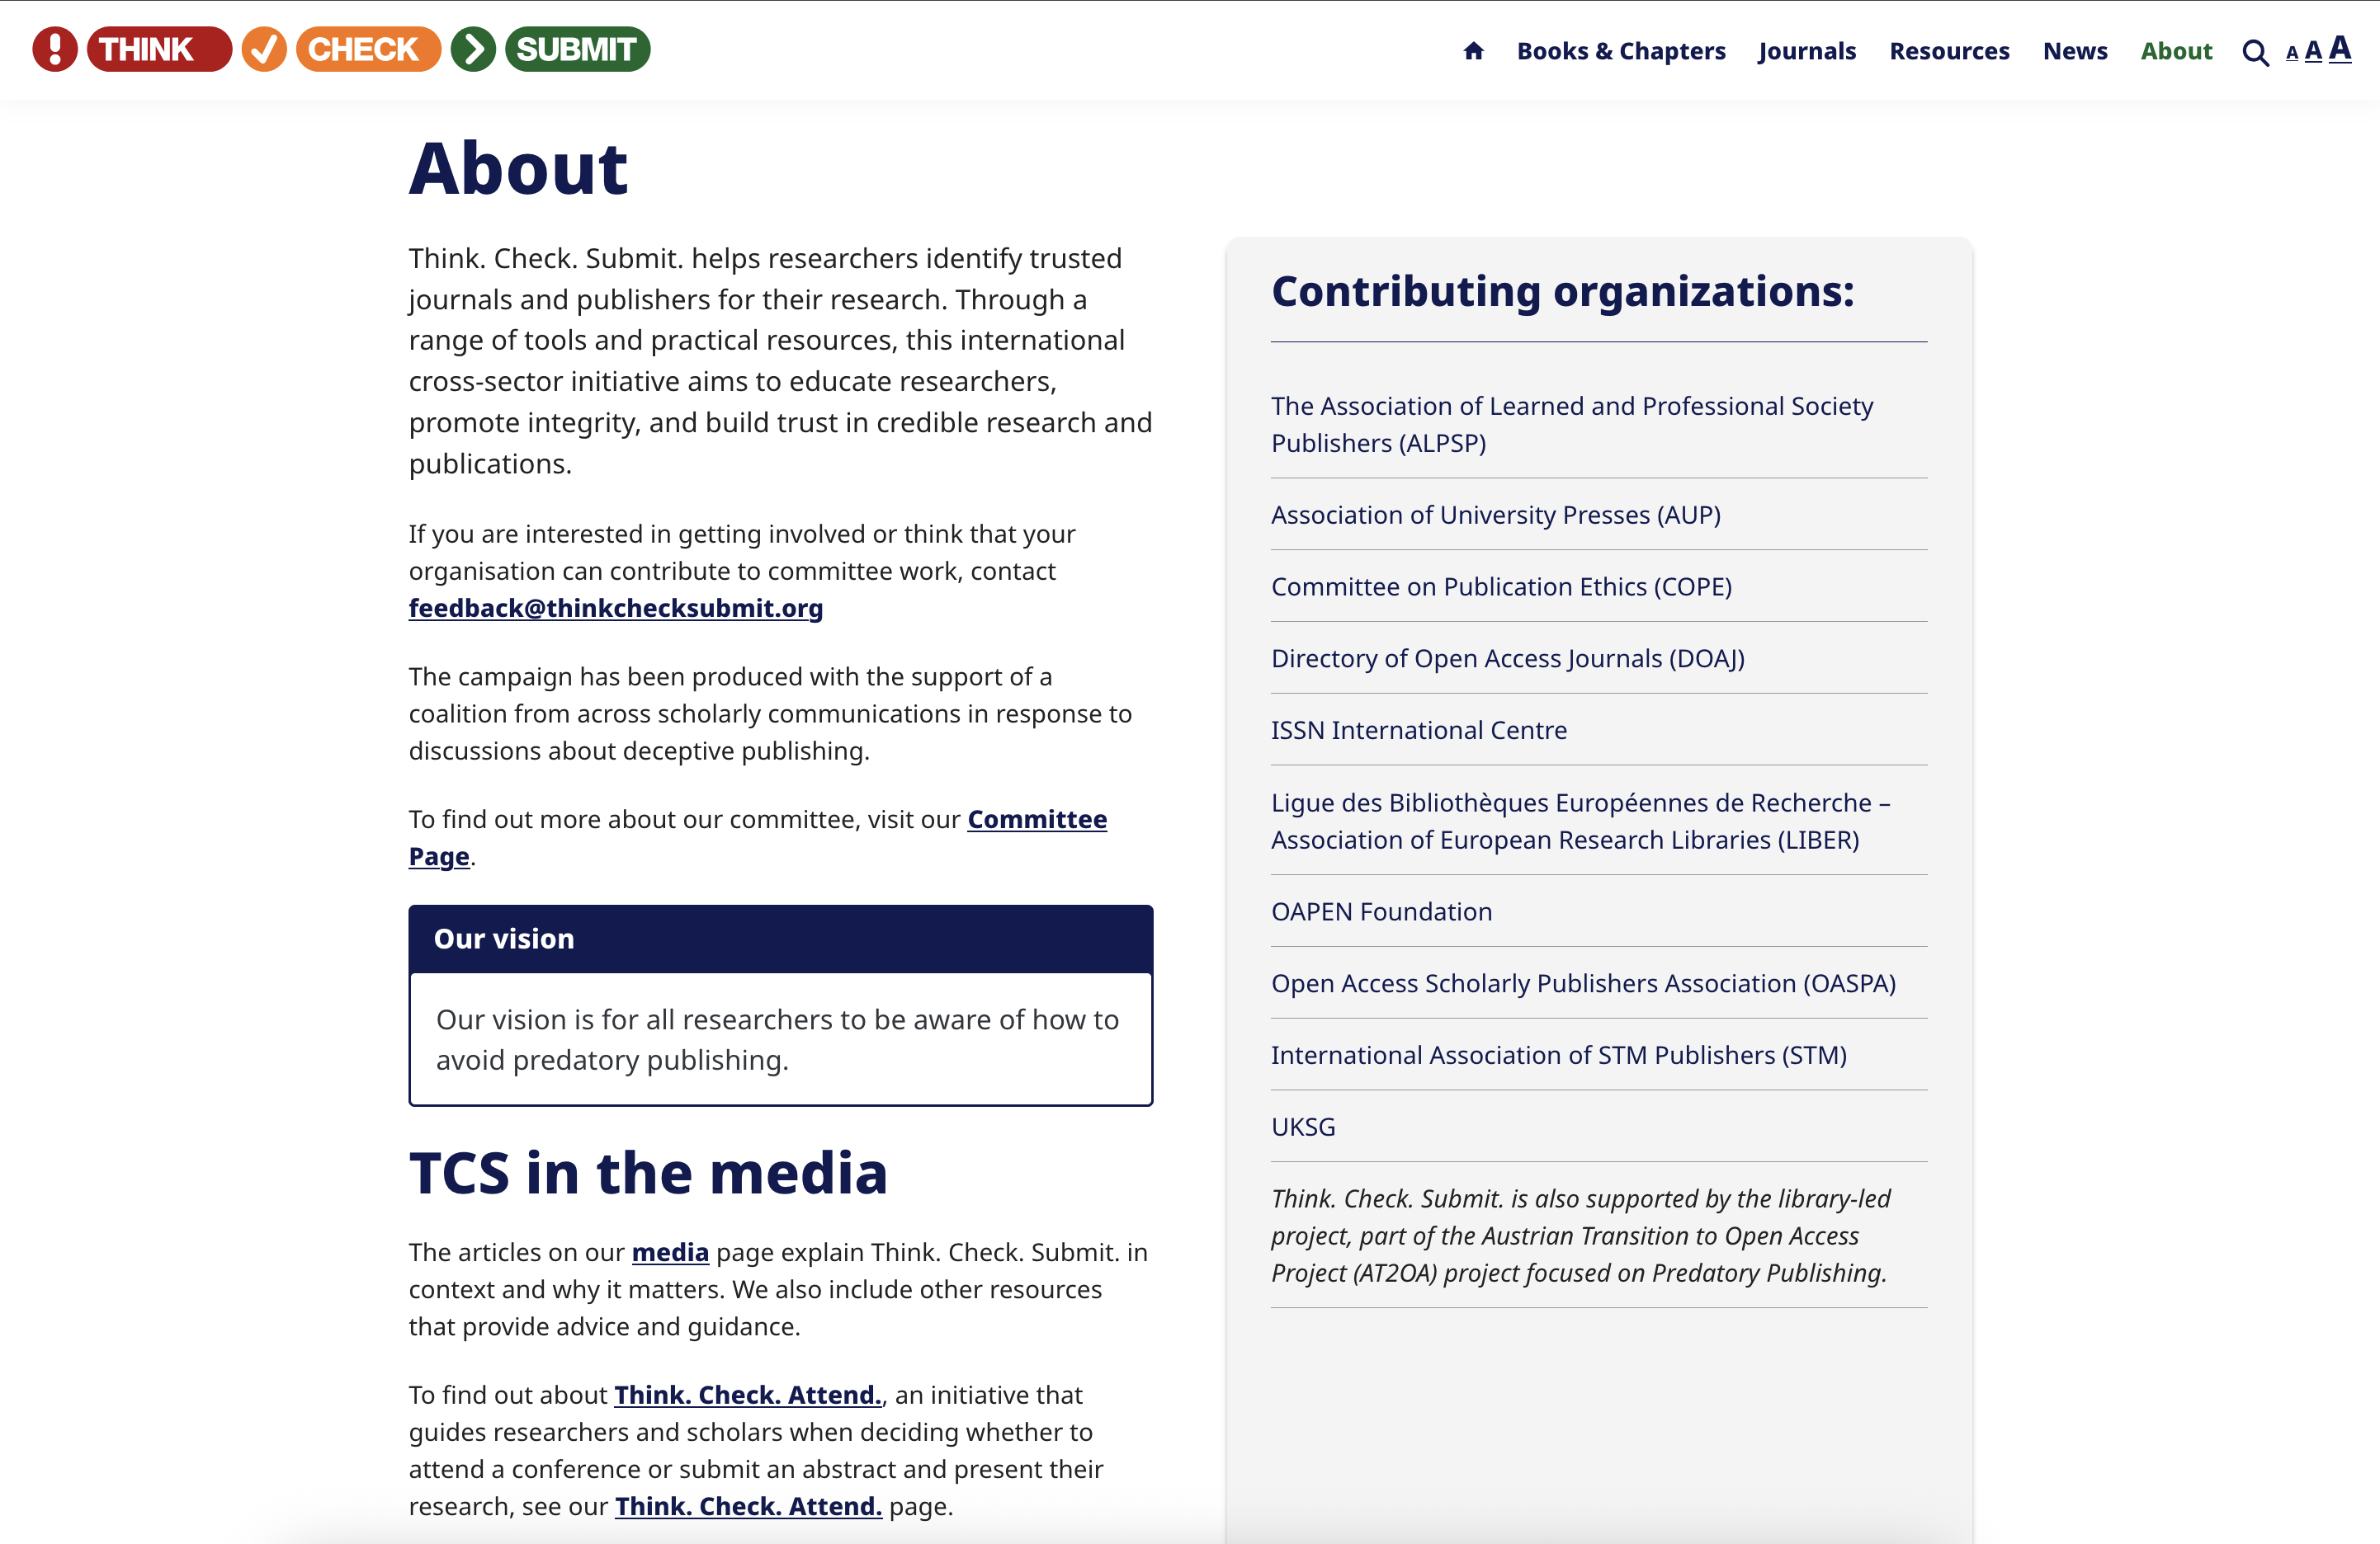
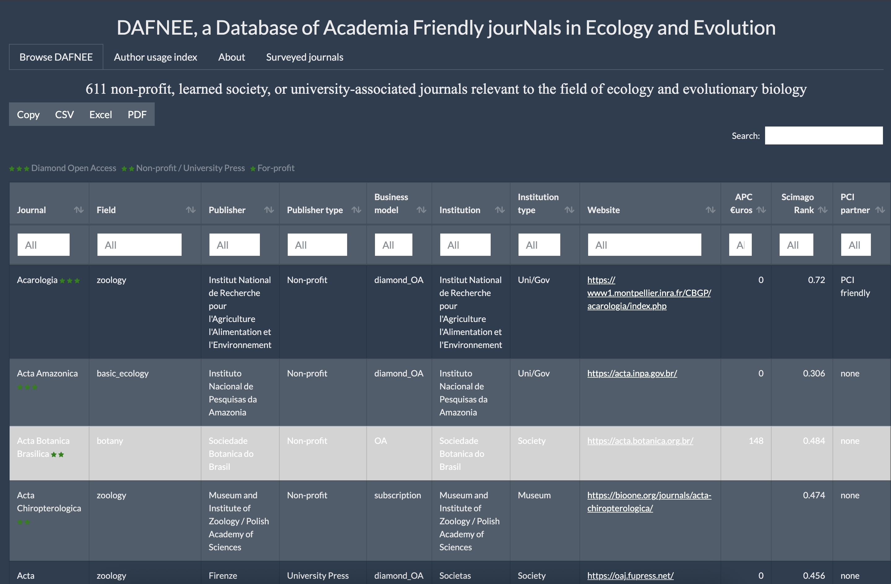
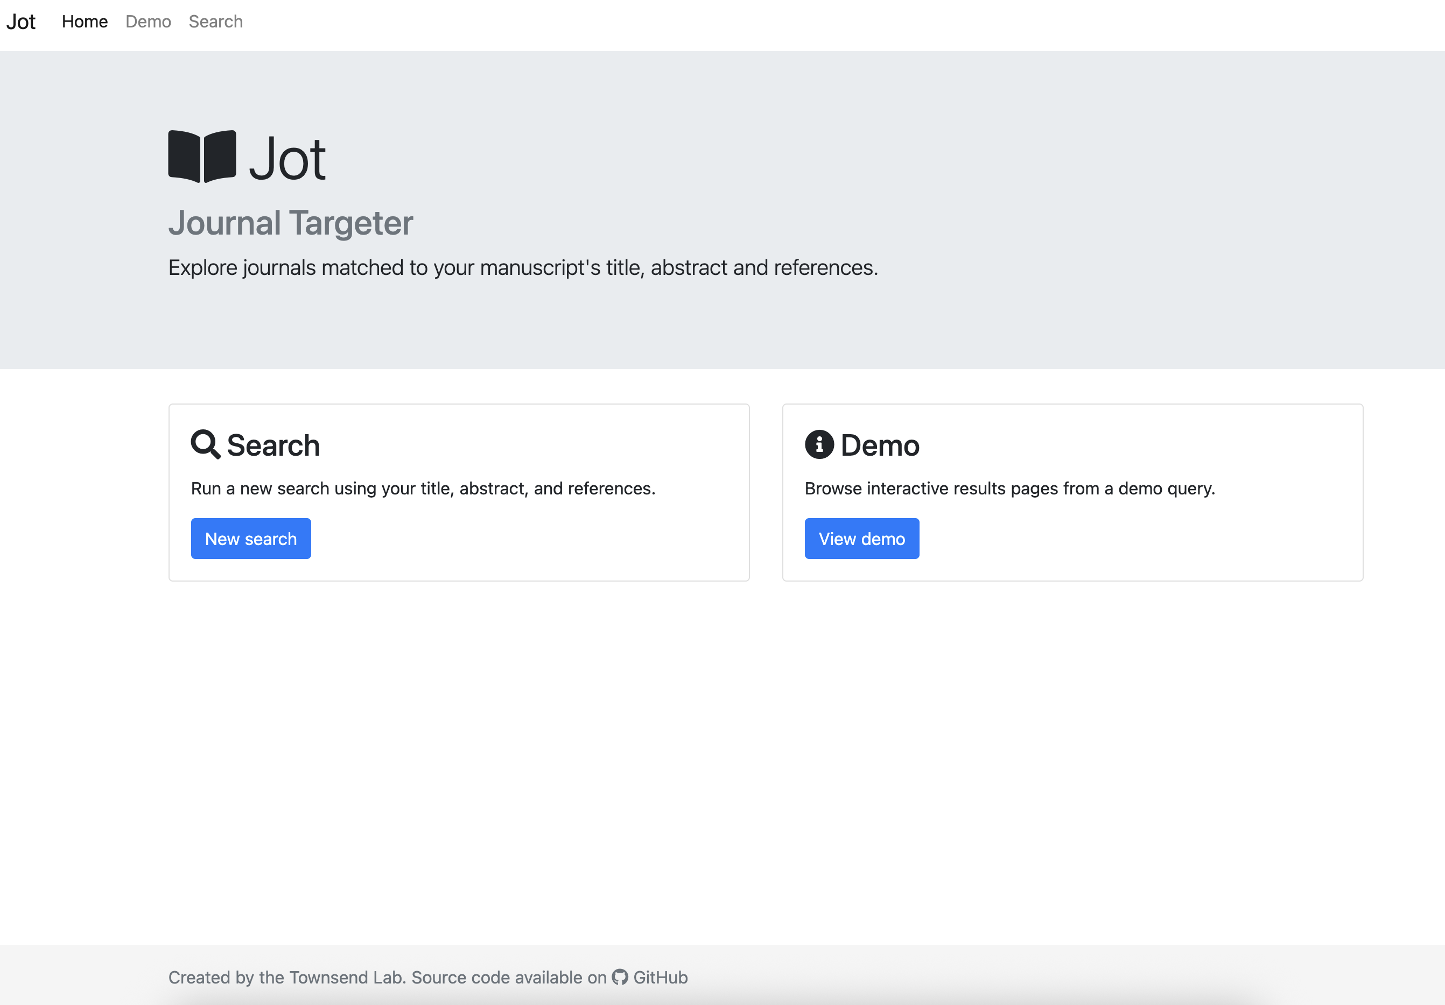

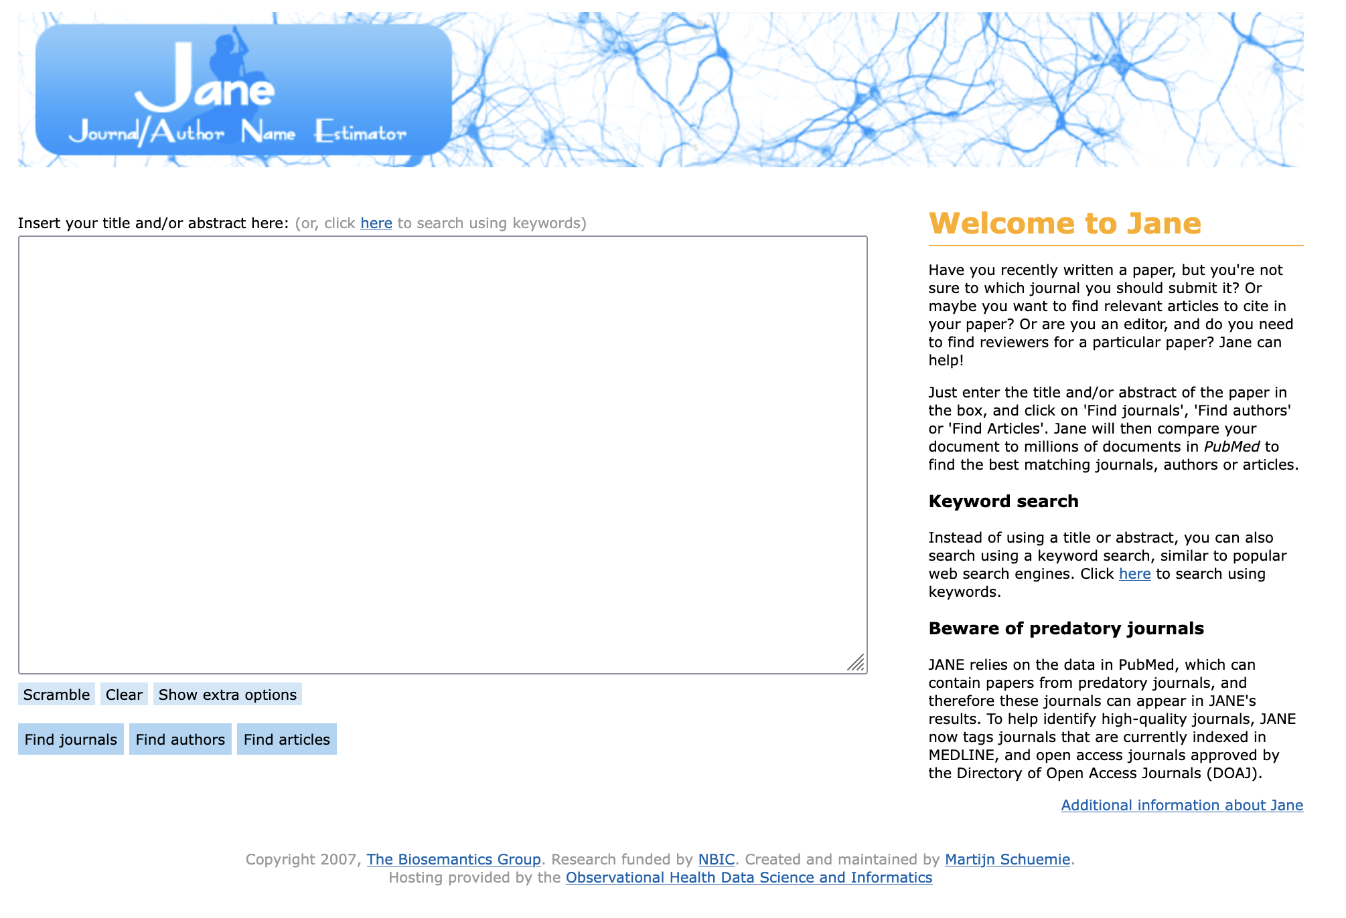

Choosing a journal: six helpful resources?
Notes:
If those are your shared goals, then how do you find journals that meet your goals?
Here are six resources (tailored toward biogeography, ecology, evolution, though some work for any discipline, e.g. FOAA, JOT, JANE, think.check.submit)

Slide 33
The journal has a transparent ownership structure, and is controlled by and responsive to the scholarly community.
Authors of articles in the journal retain copyright.
All articles are published open access and an explicit open access licence is used.
Submission and publication is not conditional in any way on the payment of a fee from the author or its employing institution, or on membership of an institution or society.
Any fees paid on behalf of the journal to publishers are low, transparent, and in proportion to the work carried out.
https://fairoa.org/
Notes:
The criteria seem generally good … but
- Who are members?
- What activities do they support?

Slide 34
https://thinkchecksubmit.org/about/
Checklist at https://thinkchecksubmit.org/journals/
Notes:
Worth checking out who are members – just for information / discussion
If you have time, walk folk through some parts of the submission checklist, which you can download here: https://thinkchecksubmit.org/journals/

Slide 35
Galtier, N., et al. (2025)
Time to publish ethically: DAFNEE, a database of academia-friendly journals in ecology and evolutionary biology.
J. Evol. Biol. voaf143, https://doi.org/10.1093/jeb/voaf143
https://dafnee.isem-evolution.fr/

Slide 36
https://jot.publichealth.yale.edu
Notes:
Before you start the workshop, make sure you have a title and abstract at hand
Paste them into the JOT browser and then discuss the outcomes (open versus not-open journals, impact factors and other metrics, match, etc)
=====================
AN EXAMPLE:
The following paper was published in Ecological Monographs (Dawson et al. 2014) http://dx.doi.org/10.1890/13-0871.1
Dispersal potential and population genetic structure in the marine intertidal of the eastern North Pacific
Population genetic theory and empirical comparisons of sister and sympatric marine species show that life history traits related to dispersal, such as pelagic duration (PD), should affect the frequency and spatial scale of migration, and thus influence population genetic structure. However, recent global analyses have concluded that PD is poorly correlated with marine population genetic structure. Here, we identify and compare genetic structure between four pairs of synchronously diverging co-distributed (SDC) species, drawn from standardized analyses of eight eastern North Pacific rocky intertidal invertebrates and one macrophyte. We test two hypotheses: H0, that species with similar dispersal potential have similar population genetic structure, and H1, that species with higher dispersal potential have lower population genetic differentiation. We find that differences in census population size (Nc), fecundity (F ), and PD are sufficient to explain measured differences in population genetic structure (/ST, DEST) between SDC species. However, theoretical differences in migration potential, calculated as a function of Nc, F, and PD, exceed empirical differences in migration, suggesting important roles for genetic drift and natural selection in structuring marine populations in the eastern North Pacific. A quantitatively similar relationship between PD and FST has been calculated for co-distributed species from the Great Barrier Reef, suggesting that meta-analyses of SDC species may reveal general patterns in how species’ traits and geographical variation interact to structure populations.

Slide 37
*
https://jane.biosemantics.org
Notes:
As the preceding slide …
Before you start the workshop, make sure you have a title and abstract at hand
Paste them into the JOT browser and then discuss the outcomes (open versus not-open journals, impact factors and other metrics, match, etc)
=====================
AN EXAMPLE:
The following paper was published in Ecological Monographs (Dawson et al. 2014) http://dx.doi.org/10.1890/13-0871.1
Dispersal potential and population genetic structure in the marine intertidal of the eastern North Pacific
Population genetic theory and empirical comparisons of sister and sympatric marine species show that life history traits related to dispersal, such as pelagic duration (PD), should affect the frequency and spatial scale of migration, and thus influence population genetic structure. However, recent global analyses have concluded that PD is poorly correlated with marine population genetic structure. Here, we identify and compare genetic structure between four pairs of synchronously diverging co-distributed (SDC) species, drawn from standardized analyses of eight eastern North Pacific rocky intertidal invertebrates and one macrophyte. We test two hypotheses: H0, that species with similar dispersal potential have similar population genetic structure, and H1, that species with higher dispersal potential have lower population genetic differentiation. We find that differences in census population size (Nc), fecundity (F ), and PD are sufficient to explain measured differences in population genetic structure (/ST, DEST) between SDC species. However, theoretical differences in migration potential, calculated as a function of Nc, F, and PD, exceed empirical differences in migration, suggesting important roles for genetic drift and natural selection in structuring marine populations in the eastern North Pacific. A quantitatively similar relationship between PD and FST has been calculated for co-distributed species from the Great Barrier Reef, suggesting that meta-analyses of SDC species may reveal general patterns in how species’ traits and geographical variation interact to structure populations.

Slide 38




PEEER: Publishing for an Ethical and Equitable Environment in Research
To build a community of authors, editors, reviewers, libraries, publishers, and societies to support affordable and equitable access plus a healthy scientific and research community.
In doing so, to change scientific publishing for the better.
https://peeer.net/
@peeer (https://x.com/peeer295544)
@peeer.bsky.social
@PEEER
#BetterPublishing
peeeresearch@gmail.com
Notes:
PEEER maintains a list of society-owned journals that publish biogeographical work at
https://peeer.net/journals/

Slide 39




Another simpler approach? Societies and …
Free Association
Biogeographers
o f
Notes:
Oftentimes, a shorthand for finding a suitable journal is to look for society journals
These examples from biogeography, ecology, evolution – most of these, and some others, have signed on to the PEEER Society Joint Statement https://peeer.net/societies/

Slide 40
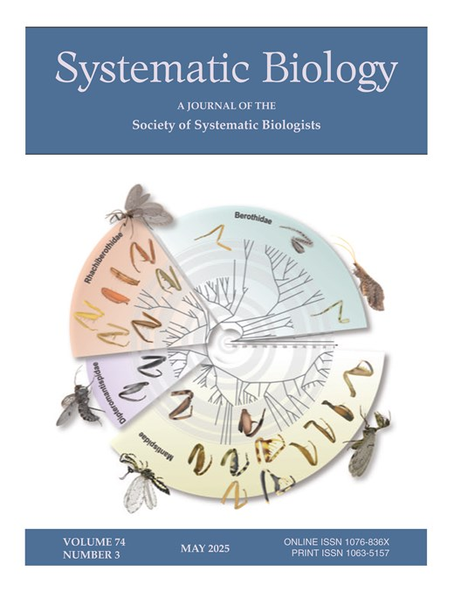
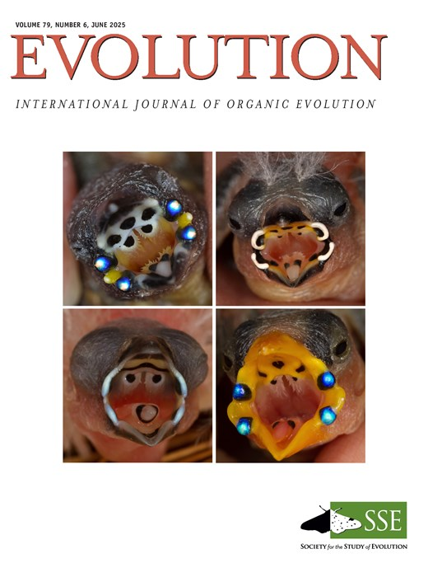
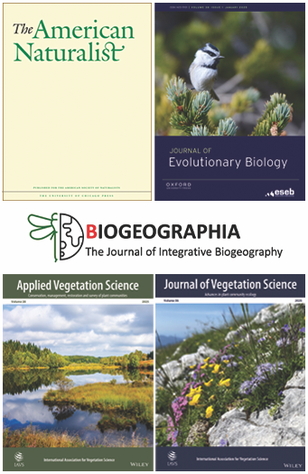
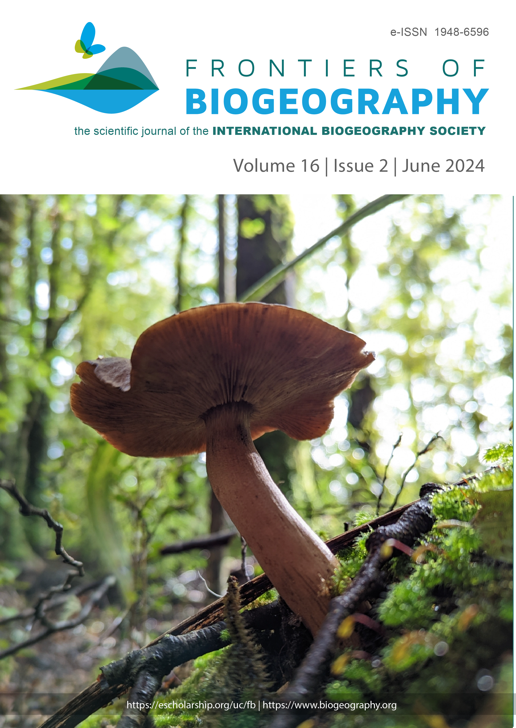


… society journals?
Notes:
These are their journals

Slide 41
Additional benefits
Discounted rates (OUP – 23%)
A proportion of the margins support society activities
Edited and reviewed by colleagues and potential mentors
Rigorous review
… but some caveats
- some ‘society’ journals are owned by for-profit publishers
- others still support for-profit publishers, e.g. Wiley
- these risks will increase
https://peeer.net/journals/
Notes:
They come with added benefits for members and early career researchers …
… but beware that it is not a hard-and-fast rule. Moreover, as the community shifts its allegiances toward society journals, for-profit publishers are likely to adjust their positions to once again exploit the community. So, in the future it may be necessary to watch out for publisher-owned societies, society-owned journals in name only, etc.

Slide 42
Foundational papers
Foundations of Ecology
Classic Papers with Commentaries
Edited by Leslie A. Real and James H. Brown
1991 Chicago University Press, w/ ESA
40 classic papers, including:
American Naturalist – 4 (ASN; 1867)
Biometrika – 2 (OUP; 1901)
Ecological Monographs – 4 (ESA; 1931)
Ecology – 7 (ESA; 1920)
Evolution – 1 (SSE; 1947)
Journal of Ecology – 3 (BES; 1913)
Nature – 1 (Springer-Nature; 1869)
Science – 3 (AAAS; 1880)
Annual Review of Ecology and Systematics
Bulletin of the Illinois State Natural History Survey
Bulletin of the Torrey Botanical Club
Heredity
Hilgardia
Pollen et Spores
Proceedings of the Zoological Society, London
Symposia on Quantitative Biology
The Auk
The Botanical Gazette
The Canadian Entomologist
The Quarterly Review of Biology
Notes:
https://press.uchicago.edu/ucp/books/book/chicago/F/bo3613618.html#anchor-table-of-contents
One of the other reasons for choosing society-owned journals is that these are the places that the history of science, truly classic papers, are published. We should want them to survive, prosper, and be the places that future scientists consult in 5, 10, 25, 50, 100 yrs etc.

Slide 43
Understanding
the
Process
Instructions
for
Authors
Editors
and
Reviewers
Six indispensable resources once you have chosen a journal
Elements of
Scientific
Writing Style
Well-
appointed
Figures
Your
Peer
Network
Notes:
So, once you have chosen a journal, how to increase your chances of success as an author? Here are six recommendations, based on the experiences of a suite of authors, reviewers, and editors …

Slide 44
Understanding
the
Process
Instructions
for
Authors
Editors
and
Reviewers
Six indispensable resources once you have chosen a journal
Elements of
Scientific
Writing Style
Well-
appointed
Figures
Your
Peer
Network

Slide 45
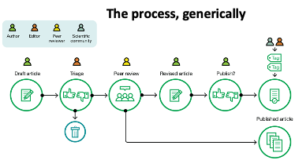
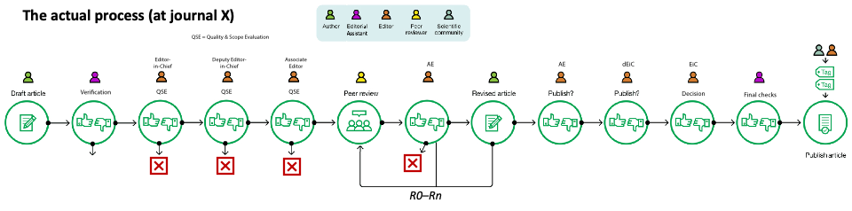

Understanding the Process
Graphically speaking … what happens after you submit?
The process, generically
‘predatory’
Pre-prints
$?
$
PCI
Let’s unpack this a little!
Notes:
Journal processes are structured in a variety of ways …

Slide 46
Understanding the Process
Core/Traditional model … what happens after you submit?
Prepare
nice mst
Respond constructively
to reviews & editors
If the decision is delayed,
write to ask the editor!
This goes quicker if the manuscript is interesting & well-presented!!
often adds most time!

Slide 47
Understanding
the
Process
Instructions
for
Authors
Editors
and
Reviewers
Six indispensable resources once you have chosen a journal
Elements of
Scientific
Writing Style
Well-
appointed
Figures
Your
Peer
Network
Notes:
How to write a scientific manuscript – a few general guidelines for all manuscripts

Slide 48
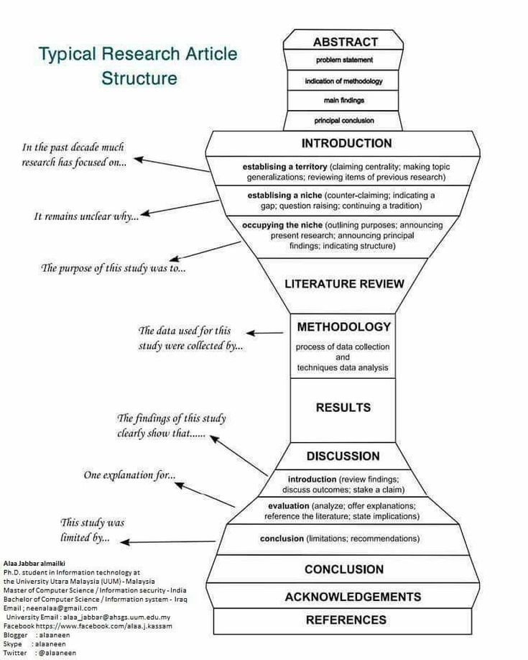
Elements of Scientific Writing Style
How to write a paper
Scientific papers are formulaic
Read lots of them, and think not only about the content but also about their structure
The formula (and deviations) will be in the Information for Authors
Follow the formula
Results should parallel Methods
Discussion should reflect Introduction. Address the key Qs & H’s, and circle back to the general topic and the gap in knowledge you identified in the Introduction
Abstract (1) can serve first as a rough outline for your paper and (2) is later a concise summary of the major points.
Broad
to
narrow
We used a Y
to collect …
We found that …
Narrow
to
broad
p.s. use an active voice!

Slide 49
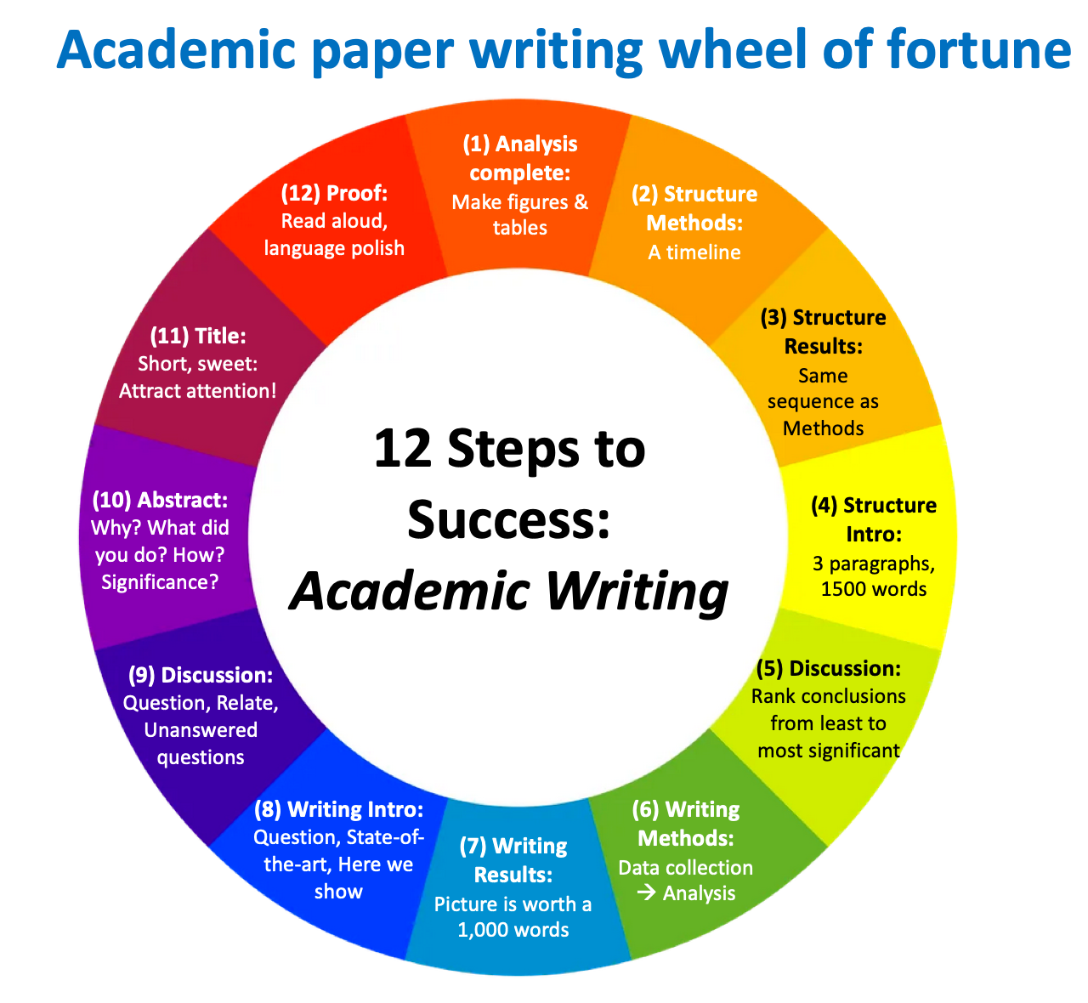
I don’t know how to write a study that I am confident will be accepted: Solutions
Some subsequent considerations:
Be organized:
Use parallel structure
Keep like with like
Use headers
Write chronologically
Be Concise, Complete, Clear.
Use short declarative statements
Use an ‘active’ voice
Make sure it looks nice, organized
*science* understandable …
scientific English is *sufficient*
AI, Grammarly *for spelling/grammar etc* only (be transparent, check journal policies)
Figures are attractive, informative (“worth 1000 words” in every language)
Write to editors beforehand — include abstract, cover letter, (full mst) — to confirm scope/fit
Notes:
Assess the quality of the manuscript and fit to the journal – a much lost skill
Trade-off cycling through journals and reviews … or hit the button on the nose first time?
Prepare a nice mst first, impress the editors, reviewers … or send them effectively an unfinished mst
(review is not capricious … especially if done well)

Slide 50
Understanding
the
Process
Instructions
for
Authors
Editors
and
Reviewers
Six indispensable resources once you have chosen a journal
Elements of
Scientific
Writing Style
Well-
appointed
Figures
Your
Peer
Network
Notes:
While writing the manuscript, be sure also to check ‘Instructions for Authors” which will provide details about how to prepare the manuscript for a specific journal. Often best to identify the target journal during writing and then useful to incorporate the I4A guidance as you go along, rather than wait until you have a manuscript.

Slide 51
Instructions for Authors
How to prepare your manuscript
Every journal will have a page describing how to tailor your manuscript to the journal.
Sections (e.g. research, opinion, review …)
Structure (e.g. for a research paper: Title, author information, Abstract, keywords, Introduction, …)
Length (e.g. abstract: words; manuscript: words, pages)
In-line citations (e.g. chronological or alphabetical order)
References format (e.g. >10 authors, sentence/title case, journal abbreviation, …)
Line numbers
Tables
Figures
Check it. Follow it.
Look at recent papers to see it implemented.
Double-check before you submit.
Notes:
You could check a range of Information for Authors pages here, though only in a 4 hr workshop. (Insufficient time in a 3 hr workshop.)

Slide 52
Understanding
the
Process
Instructions
for
Authors
Editors
and
Reviewers
Six indispensable resources once you have chosen a journal
Elements of
Scientific
Writing Style
Well-
appointed
Figures
Your
Peer
Network
Notes:
An often under-estimated factor is the figures. But many snr editors and authors in general will first read the title, then abstract, and then skip straight to looking at the figures, so you want to make sure these are high-quality, clear, with a complete (yet concise) caption so the figure+caption stand-alone, i.e. are fully understandable in absence of the rest of the paper.

Slide 53
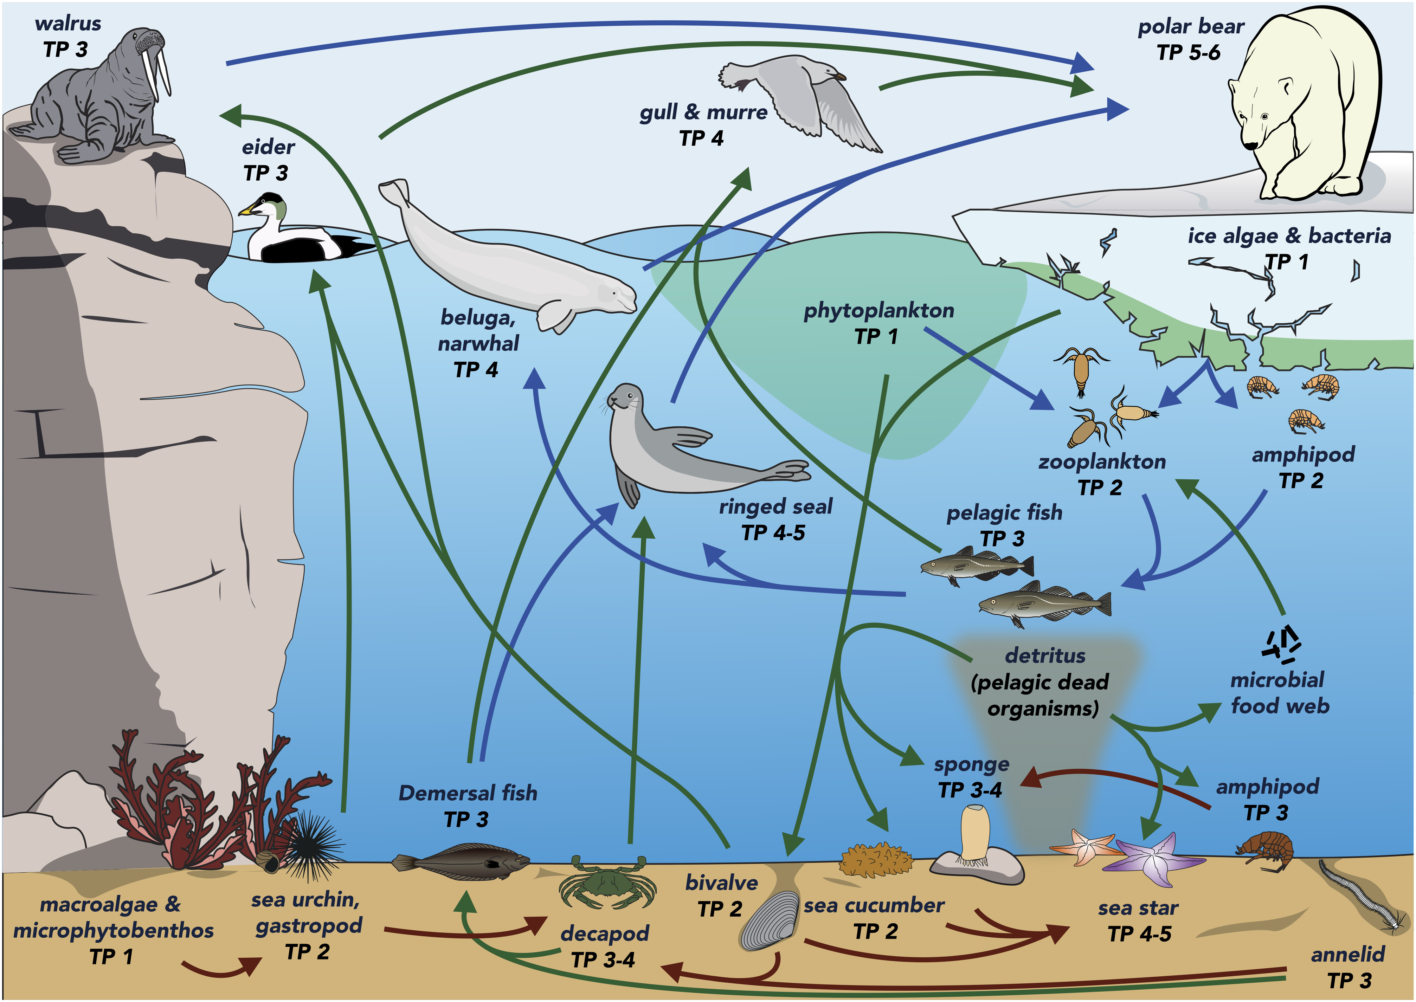
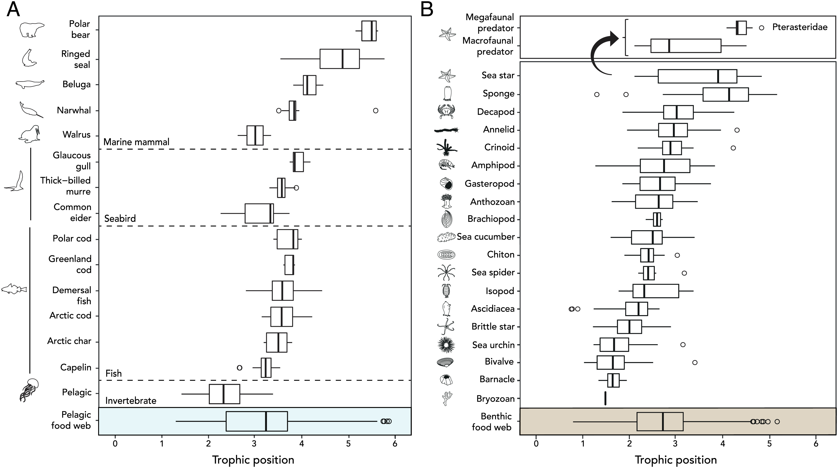
Well-appointed figures
The marine pelagic compartment spans numerous trophic levels and consists of numerous reticulate connections between species from primary producers to iconic apex predators, while the benthic compartment is perceived to be simpler in structure and comprised of only low trophic level species. Here, we challenge this paradigm by illustrating that the benthic compartment is home
A picture is worth a thousand words!
A
B
to a subweb of similar structure and complexity to that of the pelagic realm , including the benthic equivalent to iconic polar bears: megafaunal-predatory sea stars.
C
Amiraux et al. (2023) Top predator sea stars are the benthic equivalent to polar bears of the pelagic realm, Proc. Natl. Acad. Sci. U.S.A. 120: e2216701120, https://doi.org/10.1073/pnas.2216701120
Notes:
Should be sufficient to read, interpret, show objectively, the evidence for (or against) stated position - in the paper or in the relevant section
The main aim of this paper, it seems, is to convince readers that “Top predator sea stars are the benthic equivalent to polar bears of the pelagic realm” – does the figure do this? If yes, how? If no, why not?

Slide 54
Well-appointed figures
But it’s worth less, without a stand-alone caption
Schematic representation of the subarctic marine food web. Arrows indicate trophic interaction between species within the pelagic subweb (blue), the benthic subweb (brown), or between different subwebs (green).
TP of organisms collected around Southampton Island. TP of organisms belonging from the (A) pelagic subweb and (B) benthic subweb.
Amiraux et al. (2023) Top predator sea stars are the benthic equivalent to polar bears of the pelagic realm, Proc. Natl. Acad. Sci. U.S.A. 120: e2216701120, https://doi.org/10.1073/pnas.2216701120
Notes:
For example, the captions do not
- explain “TP” or a level, e.g. “TP3)

Slide 55
Understanding
the
Process
Instructions
for
Authors
Editors
and
Reviewers
Six indispensable resources once you have chosen a journal
Elements of
Scientific
Writing Style
Well-
appointed
Figures
Your
Peer
Network

Slide 56
Your Peer Network
Get feedback early and often from your co-authors and others
Other ways to learn:
Writing groups – formal & informal
Ask your PI for options to co-review manuscripts when next invited by a journal
Not a way to learn:
Submitting unpolished manuscripts to parse the peer review
Notes:
Some journals also allow PhD students to sign up for reviews but then to ask their PhD advisor to supervise the process.

Slide 57
Understanding
the
Process
Instructions
for
Authors
Editors
and
Reviewers
Six indispensable resources once you have chosen a journal
Elements of
Scientific
Writing Style
Well-
appointed
Figures
Your
Peer
Network

Slide 58
Editors and Reviewers
They’re colleagues, support good science, generously. Pretty much, they and you are the same
Don’t waste their time.
Respond to them respectfully.
Take their suggestions seriously. Accept all that you reasonably can.
OK to argue against some, but need to justify
Provide: a clear structured response, a ‘track-changes’ version, a ‘clean’ version
Let editors know you’re interested in opportunities to review
Let chief editors know you’re interested in opportunities to become an handling editor (editorial academy?)
If you get invitations …
- say yes, if in area of expertise; decline if not; accept conditionally (expert review this, not that)
- expect to take a day or two on first review … down to 0.5 – 1 day after some practice
- if mst is bad, it is not your job to fix it: review goals, major strengths, major weaknesses, why ‘reject’

Slide 59
“Peer review is dysfunctional”: Challenges (and a fact-check)
There has been, and is continued perception of, gender bias
Many have experienced being singled out for language (oftentimes clumsily)
Adequate but old technology, may be frowned upon; other limitations may not be understood (e.g. safety)
We have all had bad experiences with peer review / editors
But …
Peer review, is less biased than often perceived (see Squazzoni et al. 2021; Ceci et al. 2023).
When done well, it is constructive, provides opportunity, and is mostly consistent & predictable (single blind).
And variations (e.g. double-blind) give perception of even more impartiality.

Slide 60


AGENDA
Intro (10 mins)
Panel Discussion (50 mins)
- short break (5 mins)
Breakout Groups (55 mins)
- short break (5 mins)
Tips for publishing success (25 mins)
Q&A (25 mins)
Closing remarks / Optional: lunch - relocate to Library cafeteria
Q
&
A
Notes:
Take questions from workshop participants for the remainder of the period, bar about 5-10 mins to wrap-up.

Slide 61

AGENDA
Intro (10 mins)
Panel Discussion (50 mins)
- short break (5 mins)
Breakout Groups (55 mins)
- short break (5 mins)
Tips for publishing success (25 mins)
Q&A (25 mins)
Closing remarks / Optional: lunch - relocate to Library cafeteria
WRAP
UP!
Notes:
Amend the final line as needed, e.g. depending if/where you’re going for lunch with participants.

Slide 62
GOALS
Share hopes for, and experiences with barriers to, publishing as ECRs, and discuss ways we can overcome the barriers.
To better understand the structure of scientific publishing, including changes in recent decades, journal mechanics, and possible alternatives.
Be positioned to have greater success in publishing in your first choice journal.
Make some new friends to hang out with over the coming days!
Notes:
Reflect on the ways that you’ve achieved these goals during the workshop

Slide 63
Take-home messages
Editors are first and foremost people, researchers, authors
Editors are here to help (not ‘gatekeepers’) – you can write to them / we can correspond (judiciously).
It’s our responsibility to know the ropes as authors.
Develop a philosophy on authorship (and reviewing, editing, publishing)!
Notes:
Provide a few additional points for emphasis

Slide 64
OPPORTUNITIES:
PEEER
Sign up https://peeer.net/the-peeer-team/
Offer workshops
Create other resources; share
FAB
Sign up https://freeassociationbiogeography.org/2024/10/10/fab/
Promote the site, ideas, to your colleagues, other societies
BIOGEOGRAPHY https://biog.journals.sup.org/index.php/biog/
do ad hoc reviews –
Join our review board –
BIOGEOGRAPHY.NEWS https://biogeographynews.org/
Highlight your work –
Build a cross-platform community –
Come chat with us during the meeting … at our table outside, grab us during breaks, etc …

Slide 65
PEEER: Publishing for an Ethical and Equitable Environment in Research
To build a community of authors, editors, reviewers, libraries, publishers, and societies to support affordable and equitable access plus a healthy scientific and research community.
In doing so, to change scientific publishing for the better.
https://peeer.net/
@peeer (https://x.com/peeer295544)
@peeer.bsky.social
@PEEER
#BetterPublishing
peeeresearch@gmail.com
Notes:
Oftentimes this means society journals.

Slide 66
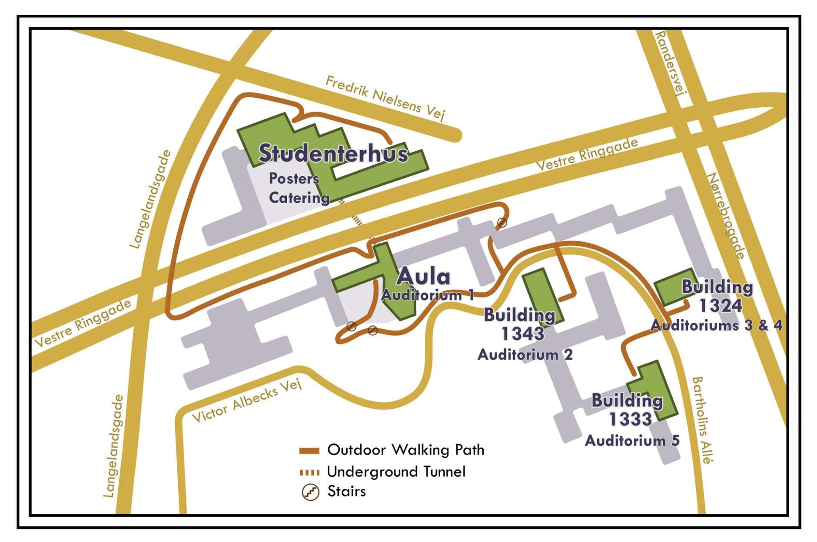
Registration
US!
Library

Slide 67
Notes:
Blank slide between preparatory notes and any additional slides

Slide 68
WILL NOT APPEAR ON THE SCREEN
(Motivations to publish and barriers to publishing)
who: What are your main motivations for publishing?
who: How do the current metrics for evaluating research (e.g., impact factor, h-index) affect your publishing choices?
Follow up question to who: As an established researcher, are your motivations for publishing the same as when you were first starting out? Do current metrics still greatly influence your publishing choices, or do you consider other factors now?
who: What are some significant barriers to publishing that early career researchers (ECRs) may face, or that you have personally encountered?
(Peer review process)
What role do editors (who)/societies (who)/publishers (who)/librarians (who) play in supporting ECRs through the publishing process?
who : How do journal publishers ensure transparency in their editorial and review processes, and what improvements could be made to increase trust in these processes?
who : What are the potential benefits and challenges of preprint servers, and how can they be effectively integrated into the publishing landscape?
who : Can ECRs act as reviewers for journals, and how can one get involved?
Follow up question to who : Have you noticed some benefits from reviewing journal articles (i.e., gained a critical eye, writing)?
(Enacting cultural change)
who : From your perspective, what are the main barriers to affordable open access publications, and how can these barriers be reduced?
who : What initiatives can journals implement to ensure a more equitable and inclusive publishing process for ECRs?
who : What role could scientific societies play in ameliorating the current situation?
who : What “we/you” as researchers can do? (e.g., only publish/review in society owned journals)
Follow up question for who: does this resonate with you? (e.g., at your career stage could you imagine progressing in your career publishing solely in society journals?)
Notes:
WARM-UP QUESTIONS for panel session, if needed
Replace “who” with either the person asking the question and/or the person being asked to answer the question. Give them pre-warning, so they can prepare the answer a little ahead of the panel itself. This is just to get things rolling if there is an awkward silence. Switch to audience questions as soon as possible!
FABRICIO’S? WORKSHOP - WARM-UP QUESTIONS IF NEEDED
(Motivations for publishing)
Motivations for publishing: Evaluations? Personal satisfaction?
What are the external pressures experienced when choosing a publishing venue?
How do the current metrics for evaluating research (e.g., impact factor, h-index) affect publishing choices
(Peer review process)
How do journal publishers ensure transparency in their editorial and review processes, and what improvements could be made to increase trust in these processes?
What are the potential benefits and challenges of preprint servers, and how can they be effectively integrated into the publishing landscape?
What role do editors/societies/publishers/librarians play in supporting ECRs through the publishing process, and how can this support be enhanced?
(Enacting cultural change)
What are the main barriers to affordable open access publications, and how can these barriers be reduced?
What initiatives can journals implement to ensure a more equitable and inclusive publishing process for researchers (think globally)?
What strategies can be implemented in different institutions to ensure that researchers from underrepresented regions and institutions have equitable opportunities in the publishing process?
What role could scientific societies play in ameliorating the current situation?
What “we/you” as researchers can do?

