Slide 1







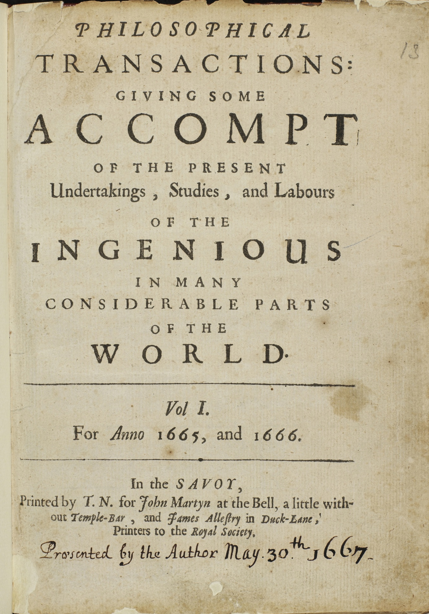




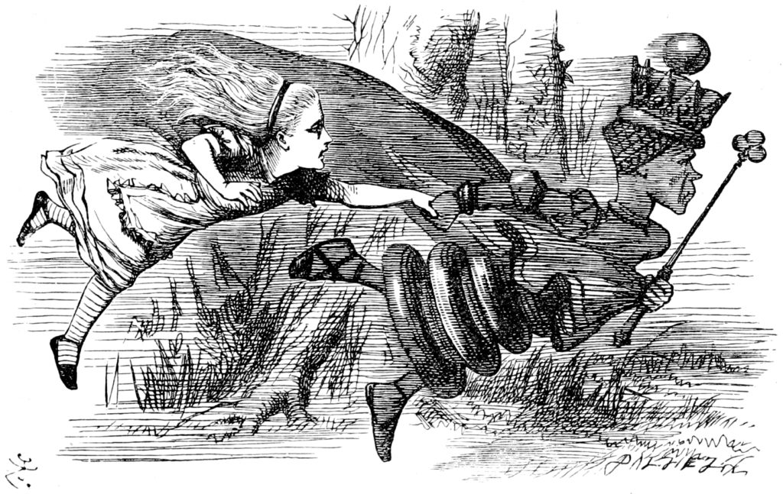

PEEER: PUBLISHING FOR AN ETHICAL AND EQUITABLE ENVIRONMENT IN RESEARCH
By PEEER
https://peeer.net/
@peeer (x.com/peeer295544)
@peeeresearch
How do you feel about your options in
the scientific publishing ecosystem?
Take our quiz!
😭
😟
😬
🙂
🥳
So many options!
How does it feel to
work at this point
in time?
To build a community of authors, editors, reviewers, libraries, publishers, and societies to support affordable and equitable access plus a healthy scientific and research community. In doing so, to change scientific publishing for the better.
PUT
A
DOT
ON
HERE
Ideas
I
Grants
G
Careers
22k
Authoring
Editing
Reviewing
R
C
Consequences Choices Change
P
The Independent Journal of …
Publish
support society journals
take action
20k
make decisions
Marketing
Strategy
And how
we can
fix it
Reviewing
has been declining for years …
Some options for spending research funds .
$
Other uses for grants
Gold Open Access APCs
who co-opted the system, leveraged open access, expanded
1 semester fees at U. California
$12290 Nature
15k
… it will be extinct by 2050!
A field season in California
$ 8890 Nature Eco Evo
2 lanes Novaseq X 25B
$ 7030 Trends Ecol Evol
How it
was
broken
$ 3640 Mol Phylogen Evol
Ideas
1 mo. 50% GSR
$~2000 Am Nat, Evol (member)
I
Grants
E
actual cost
$ 900 Frontiers of Biogeogr.
lved …
10k
$ 0 Biogeographia
G
Careers
Ideas drive research
How
Science
Works
Authoring
Editing
Reviewing
R
C
invo
Choose how
and where
you
serve
got
I
Funds
P
G
Marketing
Strategy
Papers
… for-profit publishers
By Henry Oldenburg - Philosophical Transactions, CC BY 4.0,
https://commons.wikimedia.org/w/index.php?curid=36495651
Authoring
Editing
Reviewing
R
C
Careers
A Free Association
of Biogeographers
5k
P
$$$$
Papers
then
For ~300 years, scientific publishing was run largely by scientific societies to attribute and to communicate findings …
…
START
HERE
0
1665
Notes:
Phil Trans image courtesy By Henry Oldenburg - Philosophical Transactions, CC BY 4.0, https://commons.wikimedia.org/w/index.php?curid=36495651

